Slide 1


Empowering consumers through accessible information
Results of the 2nd Consumer market study on functioning of retail electricity markets for consumers in the EU
Femke De Keulenaer (Ipsos)
© 2016 Ipsos. All rights reserved. Contains Ipsos' Confidential and Proprietary information and
may not be disclosed or reproduced without the prior written consent of Ipsos.

Slide 2
Introduction
The study is commissioned by CHAFEA acting on behalf of the European Commission
Study objectives
Assess the performance of the retail electricity market since the 2009-2010 study
Investigate if a well-functioning electricity market is in place for consumers in the EU and EEA
  Price, choice, comparability, switching, quality and access, innovation and protection of vulnerable consumers
Examine the extent to which consumers are able to make informed, rational and empowered choices
  Do they possess the necessary tools to undertake this behaviour?
  How do consumers behave in the retail electricity market?

Slide 3
CONTENT
Choice and comparability from a consumer perspective
Consumers‘ experience with switching
Consumers‘ views about electricity bills
Consumers’ views on availability and quality of information
Enforcement issues linked to the Third Energy Package

Slide 4
Introduction
Five tasks
TASK 1: Stakeholder consultation; regulatory review
TASK 2: Consumer survey (mixed-mode) in EU28, Norway & Iceland
TASK 3: Price/tariff collection and analysis of affordability
TASK 4: Mystery shopping replicating consumers’ experiences
TASK 5: Behavioural experiment examining consumers’ behaviour
Notes:
TASK 5: Behavioural experiment to examine consumers’ behaviour in terms of understanding and choice of electricity offers

Slide 5
Consumers‘ views about electricity bills

Slide 6
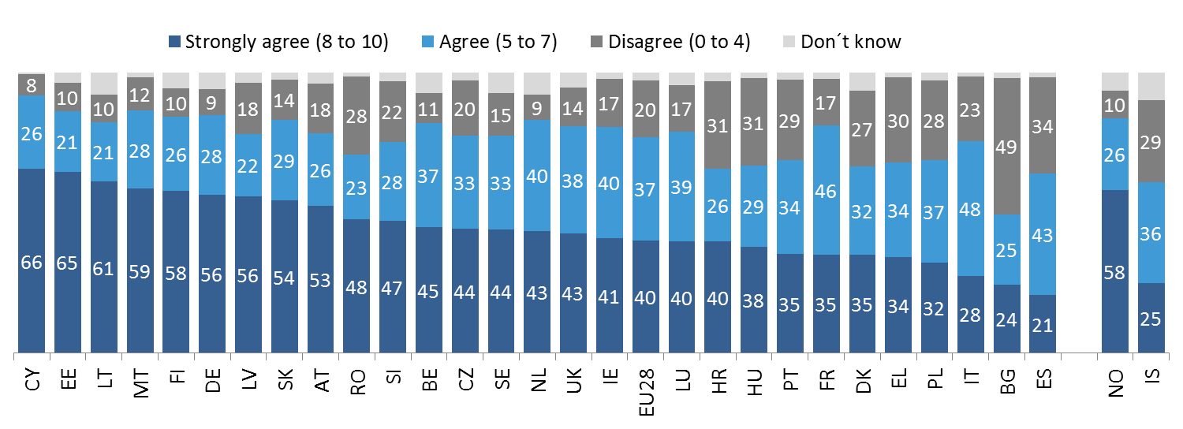
Agreement with statement: “bills of my electricity company are easy and clear to understand” (consumer survey)
Across the EU28, 40% of survey respondents “strongly agreed” that the electricity bills of their electricity company were easy and clear to understand.
A very large variation was observed across Member States: the proportion of “strongly agreeing” varied between 21% in Spain and 66% in Cyprus.
Q2_7. The following question deals with the quality of services offered in the electricity retail market. Please indicate how much you agree or disagree with each of the following statements, using a scale from 0 to 10, where 0 means that you “totally disagree” and 10 means that you “totally agree”; %, by country

Slide 7
Agreement with statement: “my bill is easy to understand”
(mystery shopping)
Mystery shoppers – who were asked to study a recent electricity bill – were less likely than survey respondents to strongly agree that the bills of their electricity company were easy to understand.
Notes:
During presentation, I will explain the set-up of the mystery shopping and what would be the rationale for explaining the differences in findings.

Slide 8
Billing practices/information provided on electricity bills (mystery shopping)
Mystery shoppers studied a recent bill and looked for specific items that should be included on their bill (as set out in the Electricity and Energy Efficiency Directives).
Mystery shoppers found, on average, 4.5 items (out of a list of 8 items) on their electricity bill.
Average number of items found on mystery shoppers’ bills
(Electricity and Energy Efficiency Directives)
2.2 | 3.9 | 4.5 | 4.1 | 2.6 | 4.5 | 2.3 | 4.4 | 4.5 | 4.2 | 4.1
Items included: (1) Fuel mix/energy sources (e.g. wind power, biomass); (2) National contact information point (or single point of contact where you can obtain information about your energy rights); (3) An energy mediator or third-party assistance; (4) Billing is based on actual consumption based on meter reading; (5) Base price per kWh of your tariff; (6) Details about consumption during billing period (in kWh); (7) Historical energy consumption (e.g. current energy consumption, compared to consumption for the same period in the previous year); (8) Tips on saving energy (e.g. link to a website)
Notes:
During presentation, a note will be made about annual bills.
CZ: 88% annual bills
DE: 50% annual bills
LT: 64% of shoppers used their paper bill books, and 34% evaluated the information provided via www.manoelektra.lt
PL: 18% evaluated a monthly bill, 35% a bimonthly bill, 8% a quarterly bill, 3% a bill received every 4 months, and 38% a bi-annual bill

Slide 9
Standard bill Best practice bill

Slide 10
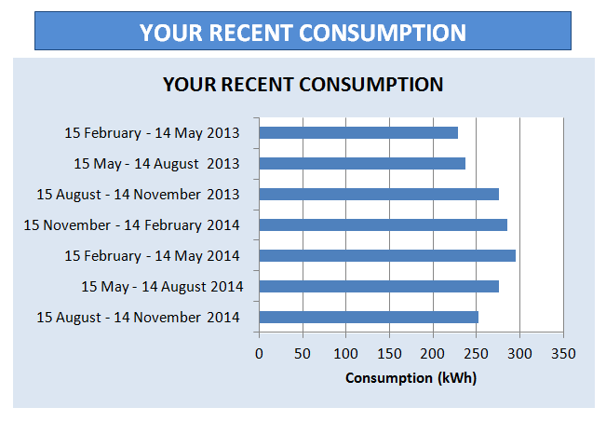
Testing consumers’ understanding of electricity bills
Results from a behavioural experiment (1)
Respondents who viewed the best practice bill (with comparability box) performed better in the comprehension exercise then those who viewed the standard bill (84% vs. 79%).
Respondents who saw the best practice bill considered that this bill was easier to understand and that it was easier to find information from this bill (compared to those who saw the standard bill).
Respondents understood graphs better than tables when reviewing information on historical energy usage (58% vs. 42%).
Notes:
Real life differences could well be larger (experiment set-up)

Slide 11
Testing consumers’ understanding of electricity bills
Results from a behavioural experiment (2)
Including “superfluous” information in bills decreases the ability of respondents to correctly answer the comprehension questions (72% vs. 68% “total unit cost of energy”).
Note: “superfluous information” included a number to call if the consumer was moving home, information on different methods of payment, and other customer service hotlines and website links for other services.

Slide 12
Choice and comparability from a consumer perspective

Slide 13
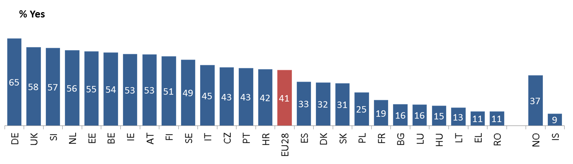
Comparing tariffs offered by different electricity companies
(consumer survey)
Across the EU28, 52% of respondents had NOT compared tariffs from different electricity companies.
A large variation was observed in the proportion of respondents who had compared tariffs from different electricity companies (from 9% in Iceland to 65% in Germany).
Q18_2. Please indicate whether each of the following statements applies to you or not: I have compared tariffs from different electricity companies
% Yes, by country, Base: all respondents; Item not asked in Cyprus, Latvia and Malta
Notes:
Context will be discussed (some countries, limited possibility to compare)

Slide 14
Q17_5. Let’s move on to choice and comparability. Please indicate how much you agree or disagree with each of the following statements, using a scale from 0 to 10, where 0 means that you “totally disagree” and 10 means that you “totally agree”: It is easy to compare tariffs from different electricity companies; % EU28, Question not asked in Cyprus, Latvia and Malta
How easy is it to compare offers from different electricity companies?
(consumer survey)
Among respondents who had compared tariffs from different electricity companies, 31% strongly agreed that it was easy to compare tariffs; the proportion disagreeing, however, was just as high – at 30%.
“It is easy to compare tariffs from different electricity companies”
Notes:
Not clear what you want to show with the first illustration

Slide 15
Why is it difficult to compare offers?
(mystery shopping and behavioural experiment)
Difficulties to estimate potential savings
When asked to estimate the savings on an annual base from switching to the cheapest tariff, 25% of mystery shoppers answered that they were not able to estimate the savings.
Complex price structure
Survey respondents in the “stay or switch” experiment were less likely to choose the cheapest deal if the price structure was more complex:
66% chose the cheapest deal when the price structure had two components:
(1) a unit price per kWh
(2) a standing charge per day
59% chose the cheapest deal when the price structure had three components:
(1) one unit price for the first batch of energy
(2) another unit price for additional energy
(3) a standing charge per day

Slide 16
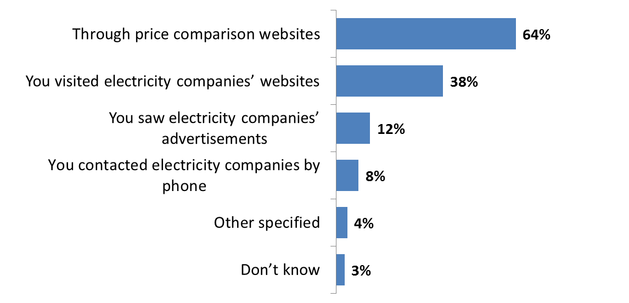
Method to compare tariffs offered by different electricity companies (consumer survey)
64% of survey respondents who had compared tariffs of different electricity companies had used comparison tools to do so , compared to 38% who had visited the websites of electricity companies.
Q20. How did you compare the offers of different electricity companies? (multiple response)
% EU28, Base: Respondents who have compared tariffs offered by different electricity companies (Q18 item 2 = Yes)

Slide 17
Consumers‘ experience with switching

Slide 18
Switching rate and respondents’ experience when switching electricity company (last three years) (consumer survey)

Slide 19
Main reasons for not trying to switch electricity company
(consumer survey)
Satisfied with your current electricity company | 42%
No difference between providers to make switching worthwhile | 24%
You never thought about the issue | 23%
Savings don't justify the trouble of changing provider | 16%
It is difficult to compare offers of different electricity companies | 14%
Switching is complicated | 12%
You dislike/distrust alternative electricity companies | 12%
There is no alternative local electricity company | 7%
You cannot find information on how to switch | 5%
You did not know that you can switch | 5%
Due to the length of the switching process | 4%
You will incur exit fees from your current electricity company | 3%
Other electricity companies are not as environmentally-friendly | 2%
In debt with current electricity company, so you can't switch | 1%
Other reason specified | 6%

Slide 20
Consumers’ views on availability and quality of information

Slide 21
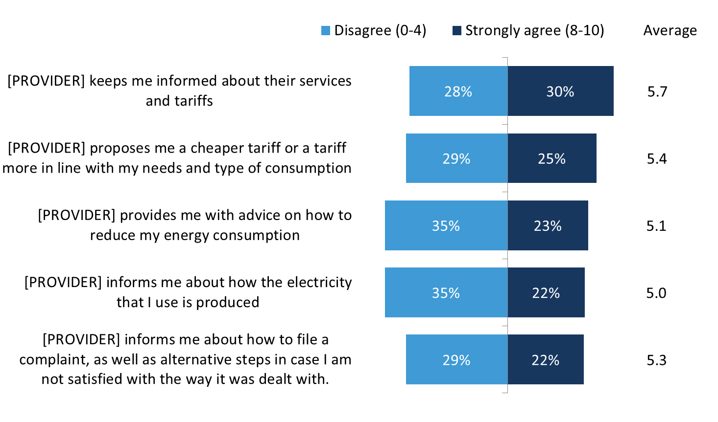
Agreement with statements about availability and quality of information (consumer survey)
Q2. Please indicate how much you agree or disagree with each of the following statements, using a scale from 0 to 10, where 0 means that you “totally disagree” and 10 means that you “totally agree”
Notes:
Medians: 6 (cheaper and services); 5 (reduce, produced, complaints)

Slide 22
Availability and quality of information (consumer survey)
Respondents in Germany and Austria were overall the most satisfied with the information provided by their electricity company; those in Bulgaria were the least satisfied.
In nine countries, a majority of respondents had an average score lower than 5 out of 10. The range was from 51% in Luxembourg to 81% in Bulgaria.
A composite index of availability and quality of information was created by averaging respondents’ scores across the five items measuring respondents’ perceptions about the availability and quality of information provided by their electricity company. Respondents with average scores between 8 to 10 were labelled as “strongly agreeing” that their electricity company informs them about various aspects, respondents with average scores between 5 and 7.9 as “agreeing” and respondents with average scores between 0 and 4.9 as “disagreeing”.

Slide 23
Enforcement
1) Receive information on energy consumption
2) Choose or change supplier without extra charges
3) Quick and efficient dispute resolution

Slide 24
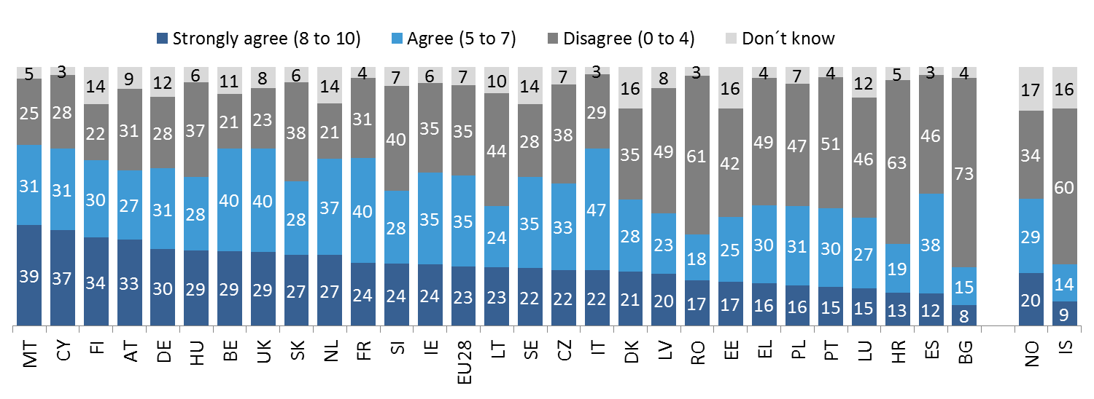
Receiving information on energy consumption:
(1) Ensuring optimal consumption (consumer survey/mystery shopping)
Across the EU28, 23% of survey respondents “strongly agreed” that their electricity company provided them with advice on how to reduce their energy consumption.
The mystery shoppers’ analysis of their electricity bills (in 10 countries) revealed that 26% of electricity bills contained tips on saving energy.
Q2_5. Please indicate how much you agree or disagree with each of the following statements, using a scale from 0 to 10, where 0 means that you “totally disagree” and 10 means that you “totally agree”: [PROVIDER] provides me with advice on how to reduce my energy consumption. %, Base: all respondents

Slide 25
Receiving information on energy consumption
(2) Information about historical energy consumption (mystery shopping)
44% of electricity bills analysed by mystery shoppers (in 10 countries) contained information about historical energy consumption.

Slide 26
Choosing or changing supplier without extra charges (mystery shopping)
On average, across the 10 countries, 17% of mystery shoppers were told that there could be a fee for cancelling their current energy deal.
In most countries, a handful of mystery shoppers was informed by the operator that there would be other extra charges when switching provider.
Electricity providers’ response when asked if there are any charges when switching provider
 | CZ | DE | ES | FR | UK | IT | LT | PL | SE | SI | Total
 | 50 | 100 | 75 | 75 | 75 | 75 | 50 | 100 | 50 | 50 | 700
You will not be charged for the change | 60% | 94% | 83% | 89% | 59% | 86% | 80% | 67% | 66% | 80% | 77%
A fee for cancelling your current energy deal (e.g. exit fee for fixed rates) | 40% | 5% | 11% | 5% | 38% | 1% | 0% | 28% | 32% | 14% | 17%
Another extra charge | 0% | 0% | 7% | 4% | 3% | 11% | 8% | 4% | 2% | 2% | 4%
No response | 0% | 1% | 0% | 1% | 0% | 1% | 12% | 1% | 0% | 4% | 2%

Slide 27
Examples of “other” extra charges (mystery shopping)
Administration cost (€35) – France; (€27.59) – Italy
Service fee (€27.90) – France
Fee for starting up the service (€27.16) – France
Activation fee – Italy, Poland
An extra charge of €20.54 on the first bill – Italy
Security deposit (€70) – Italy
Fee for a contract of less than one year – Spain
Yearly charge of 300 SEK/year for each new contract – Sweden

Slide 28
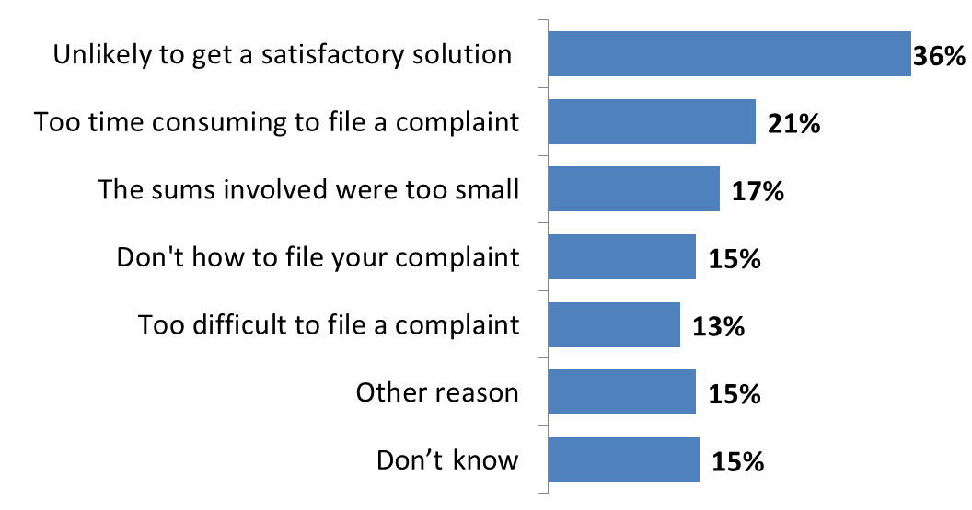
Quick and efficient dispute resolution (consumer survey)
Low satisfaction with complaint handling
23% of survey respondents, who had complained to their electricity company, reported being “very satisfied” with complaint handling; 40% were not satisfied.
Reasons for not filing a complaint: unlikely that a satisfactory solution would be reached, too time consuming, too difficult to file a complaint etc.
Q11. What were your main reasons for not filing a complaint? You can select up to three reasons.
(multiple response), EU28, Base: those who had a problem but did not complain
Notes:
This slide only refers to complaints made to electricity companies

Slide 29
Thank you!

