Slide 1
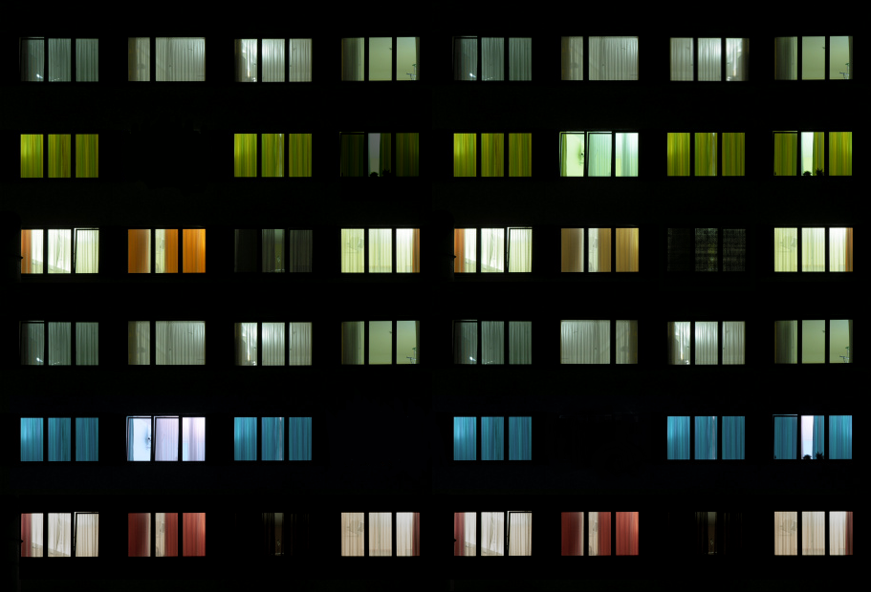
Selecting indicators to measure energy poverty
Citizens Energy Forum 24.2. 2016
Eero Ailio, DHoU, DG ENER B3
Energy

Slide 2
Objectives
How to address energy poverty? First one step back to
Agree on a general concept
Measure the level of energy poverty
Set up targeted policies to tackle energy poverty and measure the effectiveness of these policies to improve its impact.
Objectives of the study:
Identify and assess indicators for assessing energy poverty in EU28.
Test and recommend the most suitable indicators to measure it.
Review tools to facilitate the monitoring and sharing of information on measures to address energy poverty.

Slide 3
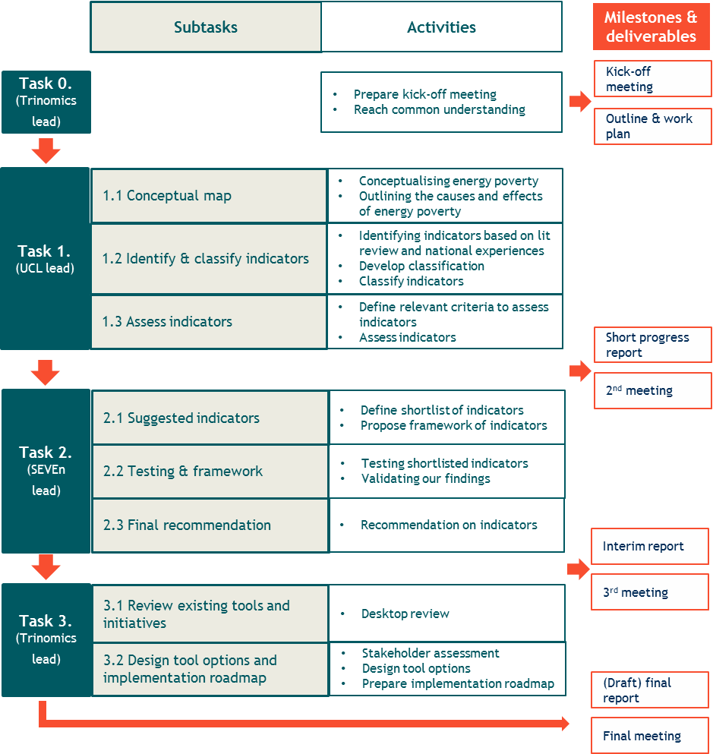



Team & Timeline
Team
Trinomics
University College London
SEVEn

Slide 4
Preliminary results
Conceptual frame for energy poverty, its drivers
182 indicators assessed
Around 10 considered in the final stage
Appraisal of the indicators
Preliminary testing

Slide 5
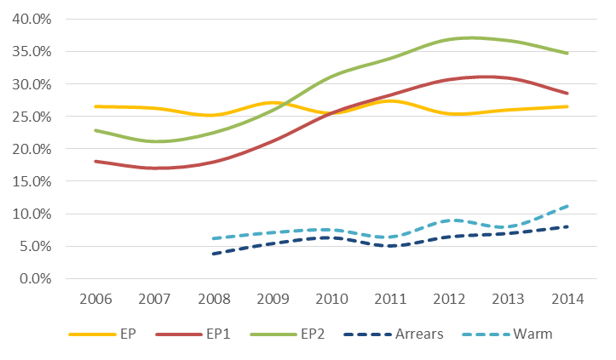
Example of preliminary results: Metrics in Spain

Slide 6
Next Steps
Final selection of indicators
Testing in three Member States
Appraisal of final set of indicators and analysis of the administrative burden of producing these indicators across the EU28
Recommendations for a tool to monitor energy poverty and share information on measures to tackle it

