Slide 1
EURELECTRIC’s vision about the evolving role of Distribution System Operators (DSOs)
Frank Mitchell
EURELECTRIC
23 February 2016

Slide 2
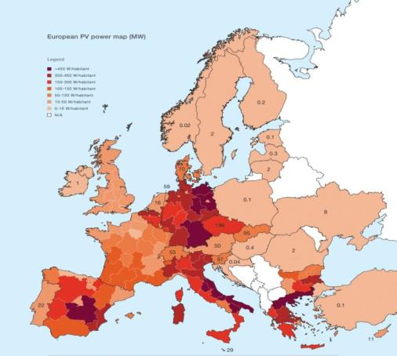
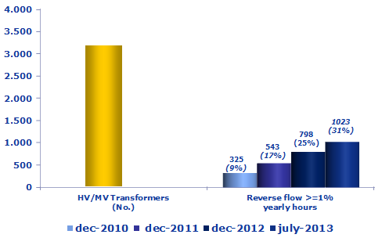
Ninety-five percent of currently installed photovoltaics capacity is connected either in LV (60%) or MV (35%)
Italy: Energy Flows at TSO-DSO boundary
Source: ENEL, 2013
Source: EPIA, 2012

Slide 3
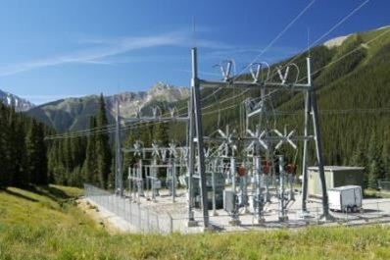
DSOs are adapting to an evolving energy market by implementing changes in the way they operate and plan their networks
DSOs are already implementing active (network or system) management solutions
DSOs should support evolving energy systems at local and regional level

Slide 4

Energy regulators should recognise the broadening role of DSOs as neutral market facilitators and encourage efficient technological innovation in the move towards smarter distribution networks

