Slide 1
The Energy Consumer Code
NEON, February 2016

Slide 2
Background
2020 Vision for Europe’s Energy Customers (November 2012)
Energy Union Strategy
‘Delivering a New Deal for Energy Consumers’ (January 2015)
Notes:
2020 Vision – 4 principles governing the relationship between the energy sector and its variety of customers:
1) Reliability
2) Affordability
3) Simplicity
4) Protection and Empowerment
- Energy Union Strategy – A joint strategy to put consumers at the centre of the energy market
- Delivering a new deal for energy consumers (Jan 2015) – A European Commission paper that identified obstacles and shortcomings in retail markets and proposed the following:
1) Shared responsibility over consumer engagement
2) Tailoring of internal energy markets for consumers
3) Full implementation of 3rd energy package
4) A common framework
This led to the proposed ‘Consumer Code’ to build a common framework/set of standards guaranteed at EU level to protect end consumers with effective standards
NEON met on 9/10 February 2016 to discuss the next steps and importance of a consumer code.

Slide 3
‘Delivering a New Deal for Energy Consumers’ (European Commission, January 2015)
Identified several obstacles and shortcomings in the current energy retail market
Examples include:
- Difficulties switching supplier
- Unclear information on energy costs and consumption
Proposed a ‘New Deal’

Slide 4
NEON Consumer Code
Aims to define a set of standards at EU level
Shared responsibility over consumer engagement
A common framework

Slide 5
Empowering consumers – Improved billing information
NEON complaint data shows majority of complaints are billing-related (38%)
Billing challenges because bill content is required by EU or national suppliers
The Consumer Code proposes:
- Unified framework across suppliers
- Information on channels for claims and
ADR

Slide 6
Tip of the Iceberg

Slide 7
A guarantee to consumers to provide energy comparison offers
Organisations in charge of ADR are best placed to evaluate neutral and reliable tools
Customer rating systems for all suppliers and offers in the market to be made widely accessible

Slide 8
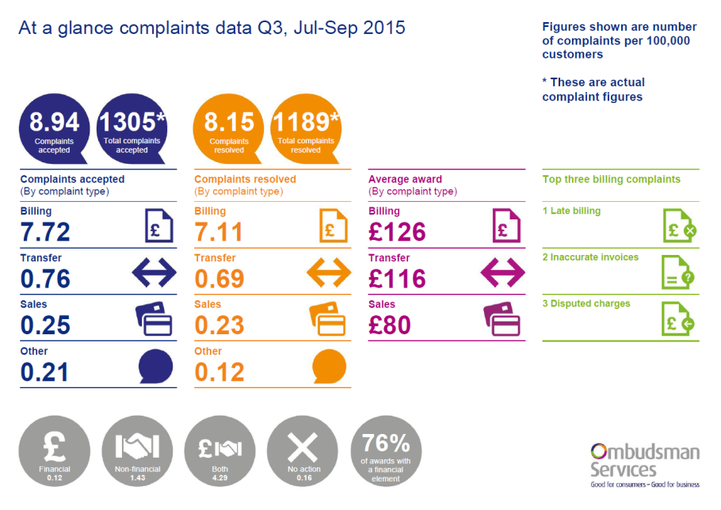
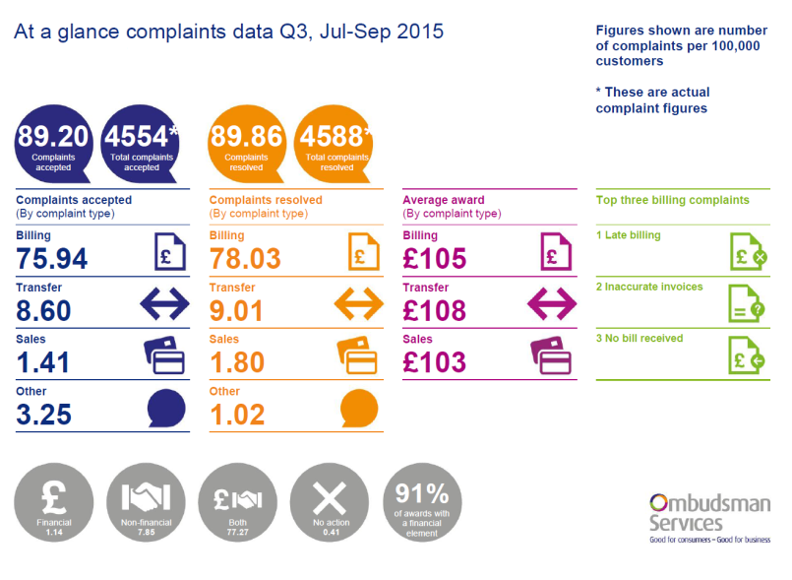
Ombudsman Services - Example
OS currently publishes quarterly complaint data for each energy company
Highlights best and worst companies for complaint handling
Links to the Consumer Code:
- Consumers can review companies
based on consumer satisfaction and
not just on price
- Need for consistency of data

Slide 9
Enabling a quick and simple switching process, without consumers facing unjustified charges and obstacles
8% of disputes handled by members of NEON were regarding switching
Consumer Code proposes:
- Removal of switching and termination fees
- Timely final bills and refunds of credit balances

Slide 10
The Consumer Code also focuses on:
Affordability
Data Management
Complaint procedures, access to ADR and redress
Prices and tariffs
Marketing and sales
Move-in and Move-out processes
Contractual terms
Unified communications
Information on real-time consumption with smart meters
Complaint procedures, access to ADR and redress

Slide 11
Increasing trust in the market
The Consumer Code sends clear and positive signals
The Consumer Code promotes shared values and best practice
The Consumer Code aims to protect end consumers with effective standards

Slide 12
“Ombudsmen have the responsibility to engage stakeholders to build trust in the energy market”

Slide 13
www.neon-ombudsman.org

