Slide 1



Universal
Smart Energy
Framework
Peter Molengraaf, CEO Alliander
A solid foundation for smart energy futures

Slide 2
More local production
More local players
And more up- and downloads of energy anywhere in the system
More variations in energy flows causes more complexity
Energy System
Yet our current market system is not designed to facilitate more interaction

Slide 3
To make the energy market truly sustainable – green, reliable and affordable- our system needs more flexibility.

Slide 4
CLASSIC
GRID
SMART GRID
Power Outage
Power Outage
Power Outage
When flex does not suffice: graceful degradation
Graceful Degradation
unused capacity
Flex to fix constraints
‘Yellow is the new green’
Flex to fix constraints
Capacity Management
Capacity Management
No constraints: normal operation
No constraints: normal operation
Free Market
Free Market
Normal Operation
Free Market
Normal Operation
Normal Operation

Slide 5
In search for a more sustainable energy system, many different pilots are initiated, often focussing on very similar energy flexibility concepts.
While technology pushes the market forward at considerable speed, we risk wasting time and money reinventing the wheel, or addressing incompatibility issues later.
USEF delivers the market structure, the tools
and the rules for energy flexibility trading. It provides a common standard for a unified
smart energy market that is easy to build on.
With existing detailed specifications and the first real-life pilots in the market, USEF is the most advanced initiative of its kind, enabling implementations to accelerate and scale rapidly and assuring product connectability.

Slide 6
The flexibility and the wholesale market should be connected to create a solution that benefits the entire system and that keeps the societal costs low.
Flexibility
Demand
Supply
Wholesale Market

Slide 7
We describe new and existing market roles with their responsibilities
and how they interact in this new extended market model
Flexibility
Demand
Supply
Wholesale Market
USEF describes the interaction in a market with three variables:

Slide 8
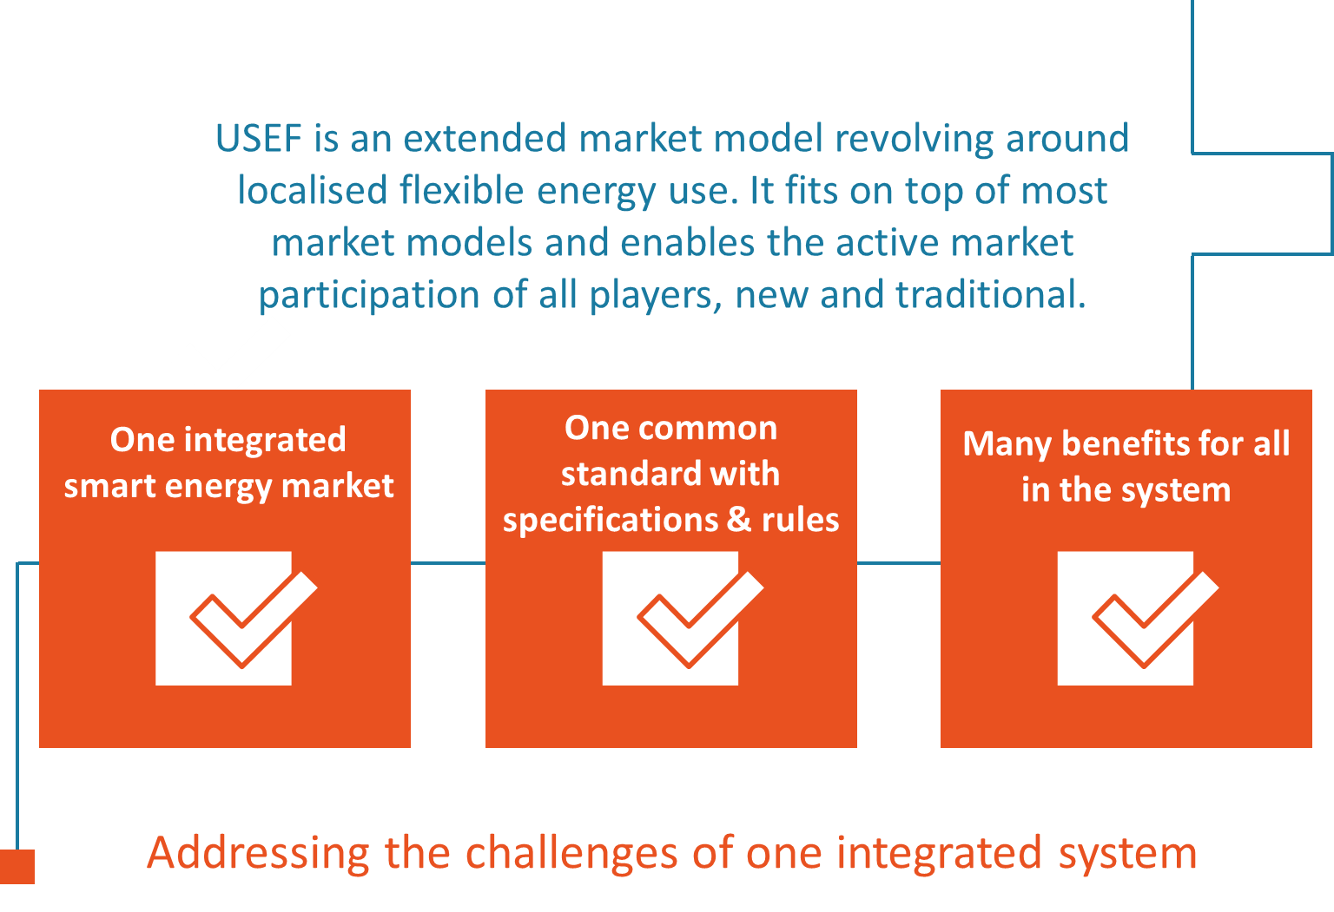


Slide 9
How working along one common standard enhances value creation
The flexibility value chain
The framework
The offer
How flexibility is used today and will be used tomorrow
How USEF supports an optimal flexibility market
Access to
specifications, designs and implementation
guidelines

Slide 10
The flexibility value chain
The framework
The offer
How flexibility is used today and will be used tomorrow
How USEF supports an optimal flexibility market
Access to
specifications, designs and implementation
guidelines

Slide 11
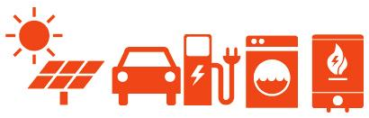
What do we need flexibility for?
Capacity
Management
Distribution System Operator
New Smart Energy System
Portfolio
Optimization
Balance Responsible Party
System
Balancing
Transmission System Operator

Slide 12



How is value created from flexibility?
Cooling
Systems
Emergency Generators
Production Process
The aggregator
A new role,
unlocking
flexibility
FLEXIBILITY
Prosumer
Heat Pump
Solar
Electric
Vehicle
Airco System
Aggregator

Slide 13



How is value created from flexibility?
Cooling
Systems
Flex for
Portfolio
optimization
Emergency Generators
UFLEX
BRP
Production Process
FLEXIBILITY
UFLEX
Flex
For grid
management
Heat Pump
Solar
Electric
Vehicle
Airco System
Aggregator
DSO
Prosumer
UFLEX
Flex to
maintain
balance
TSO

Slide 14
The flexibility value system
The framework
The offer
How flexibility is used today and will be used tomorrow
How USEF supports an optimal flexibility market
Access to
specifications, designs and implementation
guidelines

Slide 15
We believe that opening up an integral market for flexibility enables smarter solutions for energy exchange to the benefit of all in the system.
Plus, we believe that in order to create such a market, we need to work together, along one common standard, joining forces across roles and boundaries.

Slide 16
Contract
Plan
Validate
Operate
Settle
Demand
Supply
Flexibility

Slide 17
Contract
Plan
Validate
Operate
Settle
The flexibility market revolves around four basic steps, as part of the known processes:
Capability: When and how stakeholders are informed about the capability to activate
Intention: When and how stakeholders are informed about the intention to activate
Realization: When and how stakeholders are informed about the realisation of the activation (based on measurements)
Compensation: When and how stakeholders are compensated (through settlement)

Slide 18
Contract
Prosumers define the average flexibility of their energy use in line with their needs and comfort settings. This the starting point for the aggregator, who will contact the BRP and DSO to inform them about his capability to activate flex.
Plan
In the plan-phase, the aggregator looks at his portfolio of clients, each with their own individual needs and flexibility preferences. Every day, he makes a forecast for the next day: how much energy will they need – and how much flexibility can they offer?
Validate
In interaction with one or more BRPs and the DSO, the offered Flex can be utilized to optimise portfolios or to ease congestion.
Operate
For the day of operations, USEF framework prescribes what the interaction between parties should look like and how this actual usage and flexibility delivered can be measured.
Settle
The USEF framework supports the exchange and the settlement of Flex with transparent and unambiguous data.

Slide 19
The flexibility value chain
The framework
The offer
How flexibility is used today and will be used tomorrow
How USEF supports an optimal flexibility market
Access to
specifications, designs and implementation
guidelines

Slide 20

USEF describes the market for flexibility and provides access to
A set of specifications, designs and implementation guidelines
Pilot results & insights
A reference implementation to accelerate large scale deployments

Slide 21
Our solution
Integral
Open
Scalable & replicable
Market-based
And live in different demonstration projects already

Slide 22
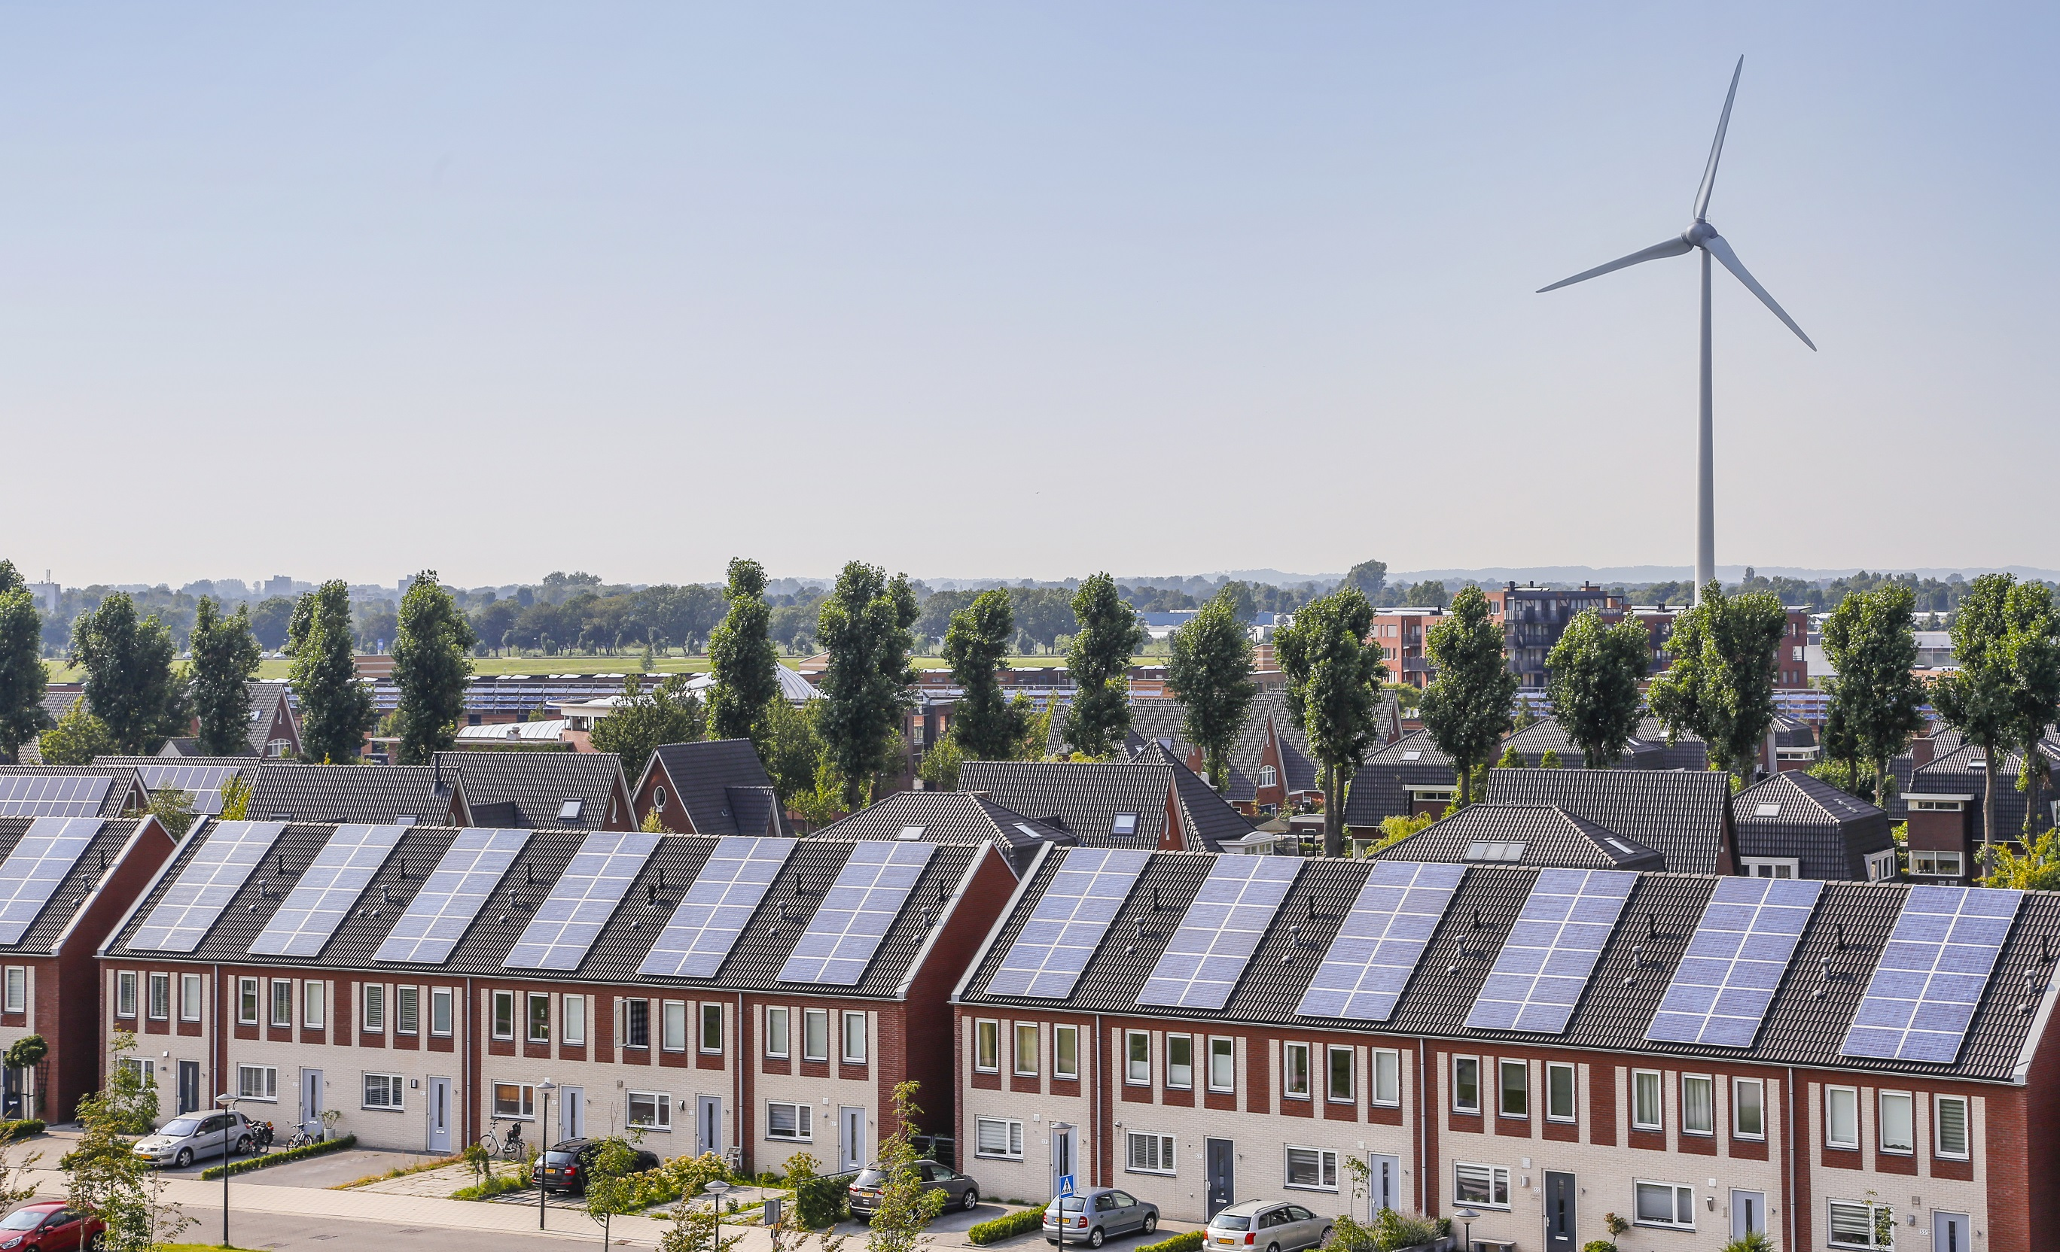

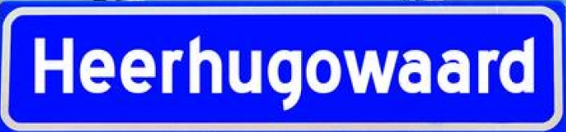
USEF implemented
Live since 18 August 2015
200 smart devices provide flexibility

Slide 23

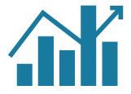


Devices are controlled automatically by the Aggregator
flex
Flex for imbalance correction
Balance Responsible Party
Heat pump (50)
Fuel Cell (15)
Electric Boiler (45)
PV Switch (90)
Aggregator
flex
flex
Flex to prevent congestion
Distribution System Operator

Slide 24
Households receive Flex fee for delivering flex to Aggregator:
Every month, the Aggregator calculates how much turnover he has made (sum of flex delivered)
The Aggregator subtracts its margin in order to pay its fixed costs and make a profit
The remaining profit is equally divided between the participating households
Dynamic tariffs are not applied
Business model of Aggregator does not make use of dynamic tariffs, because:
It was found that participating households rather receive a profit share than a variable tariff
Profit share fits very well to automatic controlling of devices; dynamic tariffs are more applicable for behavioral change
It is not possible for the aggregator to combine the price incentive of BRP and DSO into one dynamic tariff

Slide 25
Participants are positive
Each household provides about 0.5 kW of controllable flex automatically
200 million households in Europe then can provide 100 GW of flex, i.e. even without EVs. That is more than half of the total installed generating capacity in Germany (167 GW in 2011)!

Slide 26







FOUNDING
PARTNERS:
USEF, a non-commercial partnership, was founded in 2013 to design a scalable solution that recognizes the different stakeholders and their role in a coherent and commercially viable smart energy system and to accelerate its development.

Slide 27
Ambition
USEF aims to be the de facto standard for smart energy systems.
In 2020 we want to be part of 25% of all smart energy systems in at least 5 different markets.

Slide 28




Join us
A solid foundation for smart energy futures
Name: Peter Molengraaf
Email: contact@usef.info
www.usef.energy
Twitter: @USEFsmartenergy

