Slide 1
Elhub
The Norwegian datahub
A digitalised, customer-centric and highly competitive retail electricity market for Norway…
... lessons for others?
Tor B. Heiberg
Managing Director
Elhub AS
- a Statnett company -

Slide 2
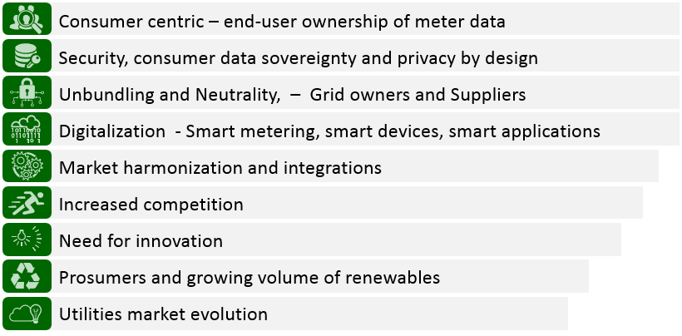
Legislation and other drivers for Norway
Notes:
The push for increased Data security and implementing Privacy by design principles

Slide 3
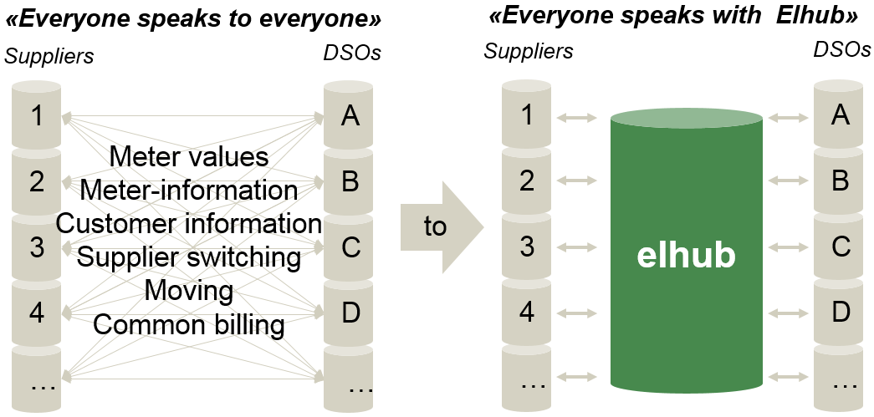
Introducing a datahub (Elhub) i

Slide 4
Introducing a datahub (Elhub) (ii)
Datahub as common data interface between DSO's and the market
From multiple ‘truths’ to single truth with transparent data for all
Overcoming market and process inefficiencies - more automation
€
Cost efficient – for industry and consumers
Enabler for further innovations both at market and end-users

