Slide 1
Alternative dispute resolution: providing consumers real effective redress
Pedro Oliveira
Legal Adviser
3 October 2013, Vilnius Lithuanian Presidency Conference on Consumer Protection

Slide 2
What is BUSINESSEUROPE?
Mission
Purpose
Pillars
“Actively promote and represent business in Europe”
“Advocate a favourable and competitive business environment to foster sustainable economic growth”
Influence EU policies to create a business-friendly environment
Members FIRST
Staff: about 50 persons
Supporting network of 57 companies (ASGroup)
Alliance for a Competitive European Industry
European Employers Network
The Confederation of European business, representative of more than 20 million small, medium and large companies
A Social Partner

Slide 3
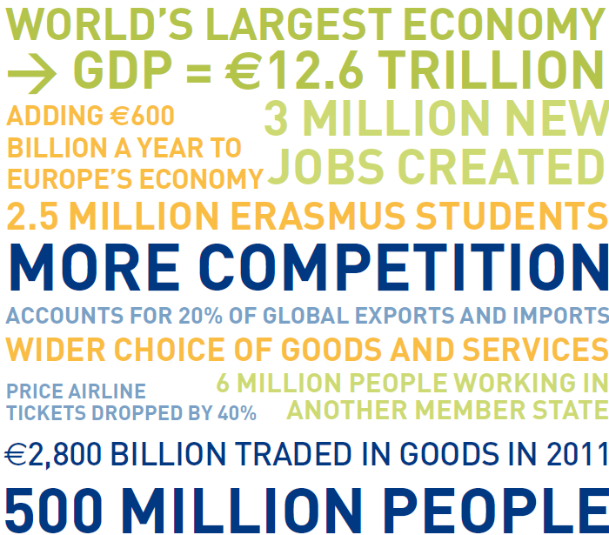
EU Single Market Month – our flagship

Slide 4
Effective redress
Important driver of consumer confidence
Fundamental for developing Digital Single Market
Shared responsibility (public and private entities)
Courts are one of the solutions BUT not the only one

Slide 5
Importance of ADRs
BUSINESSEUROPE strongly supports ADRs
It is about:
Giving consumers and businesses an effective way of solving their disputes avoiding confrontation
Costs-efficiency
Avoiding unnecessary litigation
Litigation is lengthy, complex and expensive

Slide 6
Room for improvement
Huge variety of ADRs exist
No single model
Preserving diversity, quality and efficiency
Filling the gaps, in particular in the online environment
Raising awareness

Slide 7
New ADR Directive (I)
Focuses on quality and awareness
No one-size-fits-all
Encourages first contact with trader
Access to justice remains intact
Preserves reputation
Leaves financing possibilities open

Slide 8
New ADR Directive (II)
Complex but reasonable obligations for traders
Last but not least: voluntary nature is not affected

Slide 9
New ODR regulation
Makes use of existing European tools like ECC-net
Does nor set unrealistic goals
Simplicity and user friendliness are key for businesses too
05/04/2011

Slide 10
The future of ADRs
Awareness is shared responsability:
Authorities, Institutions, Businesses and Consumers
Mentality and behaviour change are the biggest challenge

Slide 11
THANK YOUR ATTENTION
Register NOW for our BUSINESSEUROPE/LPK Event 14.10.13
‘Mutual recognition: Boosting the Single Market!’
Check our webpage: www.businesseurope.eu

