Slide 1
Project Presentation
Presented by Monique Goyens

Slide 2
Presentation Outline
Programme Introduction
Presentation of
Web Networking Platform
E-learning
Training
Next Steps
Q&A

Slide 3
Introduction
01

Slide 4
Aim of the Programme
CONSUMER CHAMPION
A unique capacity building programme for European Consumer Professionals offering training, e-learning, resources and networking opportunities for consumer professionals from across Europe.

Slide 5
Aim of the Programme
Focus on Central, Eastern and South Eastern European countries-CESEE
5 Activities:

Slide 6
Target Group
User profiles on web networking platform: Directors, Supervisors, Participants

Slide 7
Programme presentation and demo
02

Slide 8
Pillars of the Programme
Web Networking Platform features defined around 3 Pillars:

Slide 9
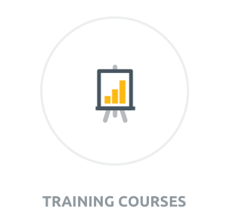
Website Features
Training Calendar
View Courses
Apply Online
Save & Edit Applications
E-learning Modules
E-tests
Complete Evaluations Online

Slide 10
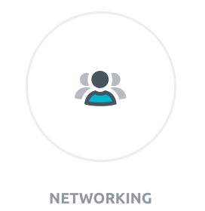
Website Features
Member Forums
Class Meeting Points
Member Directory
Organisation Directory
Instant Messaging
Share Resources
Discuss News & Events

Slide 11
Website Features
News & Events
Users Add News & Events
Live RSS News Feeds
Social Media Feed
Expert Blog & Q&A
Useful Links

Slide 12
Web Networking Platform Demo
Notes:
Image is link to:
http://siveco-test.daracreativedns.com/
Platfomr will be available for computers and mobile devices (Mobile devices by the end of the year (december)

Slide 13
E-Learning Overview
Sign Up & Apply Online
Application Approval by Supervisor & Training Team
Study Course Online
Complete E-Test
Receive Grade
Pass or Repeat
Results Saved in account
Evaluations Completed Online

Slide 14
e-learning development
COURSES AVAILABLE NOW ONLINE:
CONSUMER LAW
- English
- Croatian
- Czech
- Romanian and
- Polish

Slide 15
e-learning development
COMING NEXT:
ENERGY
Languages: English (Croatian, Czech, Romanian and Polish Coming Soon)
FINANCIAL SERVICES
Languages: English, Croatian, Czech, Romanian and Polish
TELECOMMUNICATIONS
Languages: English, Croatian, Czech, Romanian and Polish

Slide 16
E-learning Module Demo
Notes:
http://siveco-test.daracreativedns.com/sites/default/files/elearning/energy/

Slide 17
Training Overview
Sign Up & Apply Online
Application Approval by Supervisor & Training Team
Course Materials Online
Complete Course Locally
Course History Online
Evaluations Completed Online

Slide 18
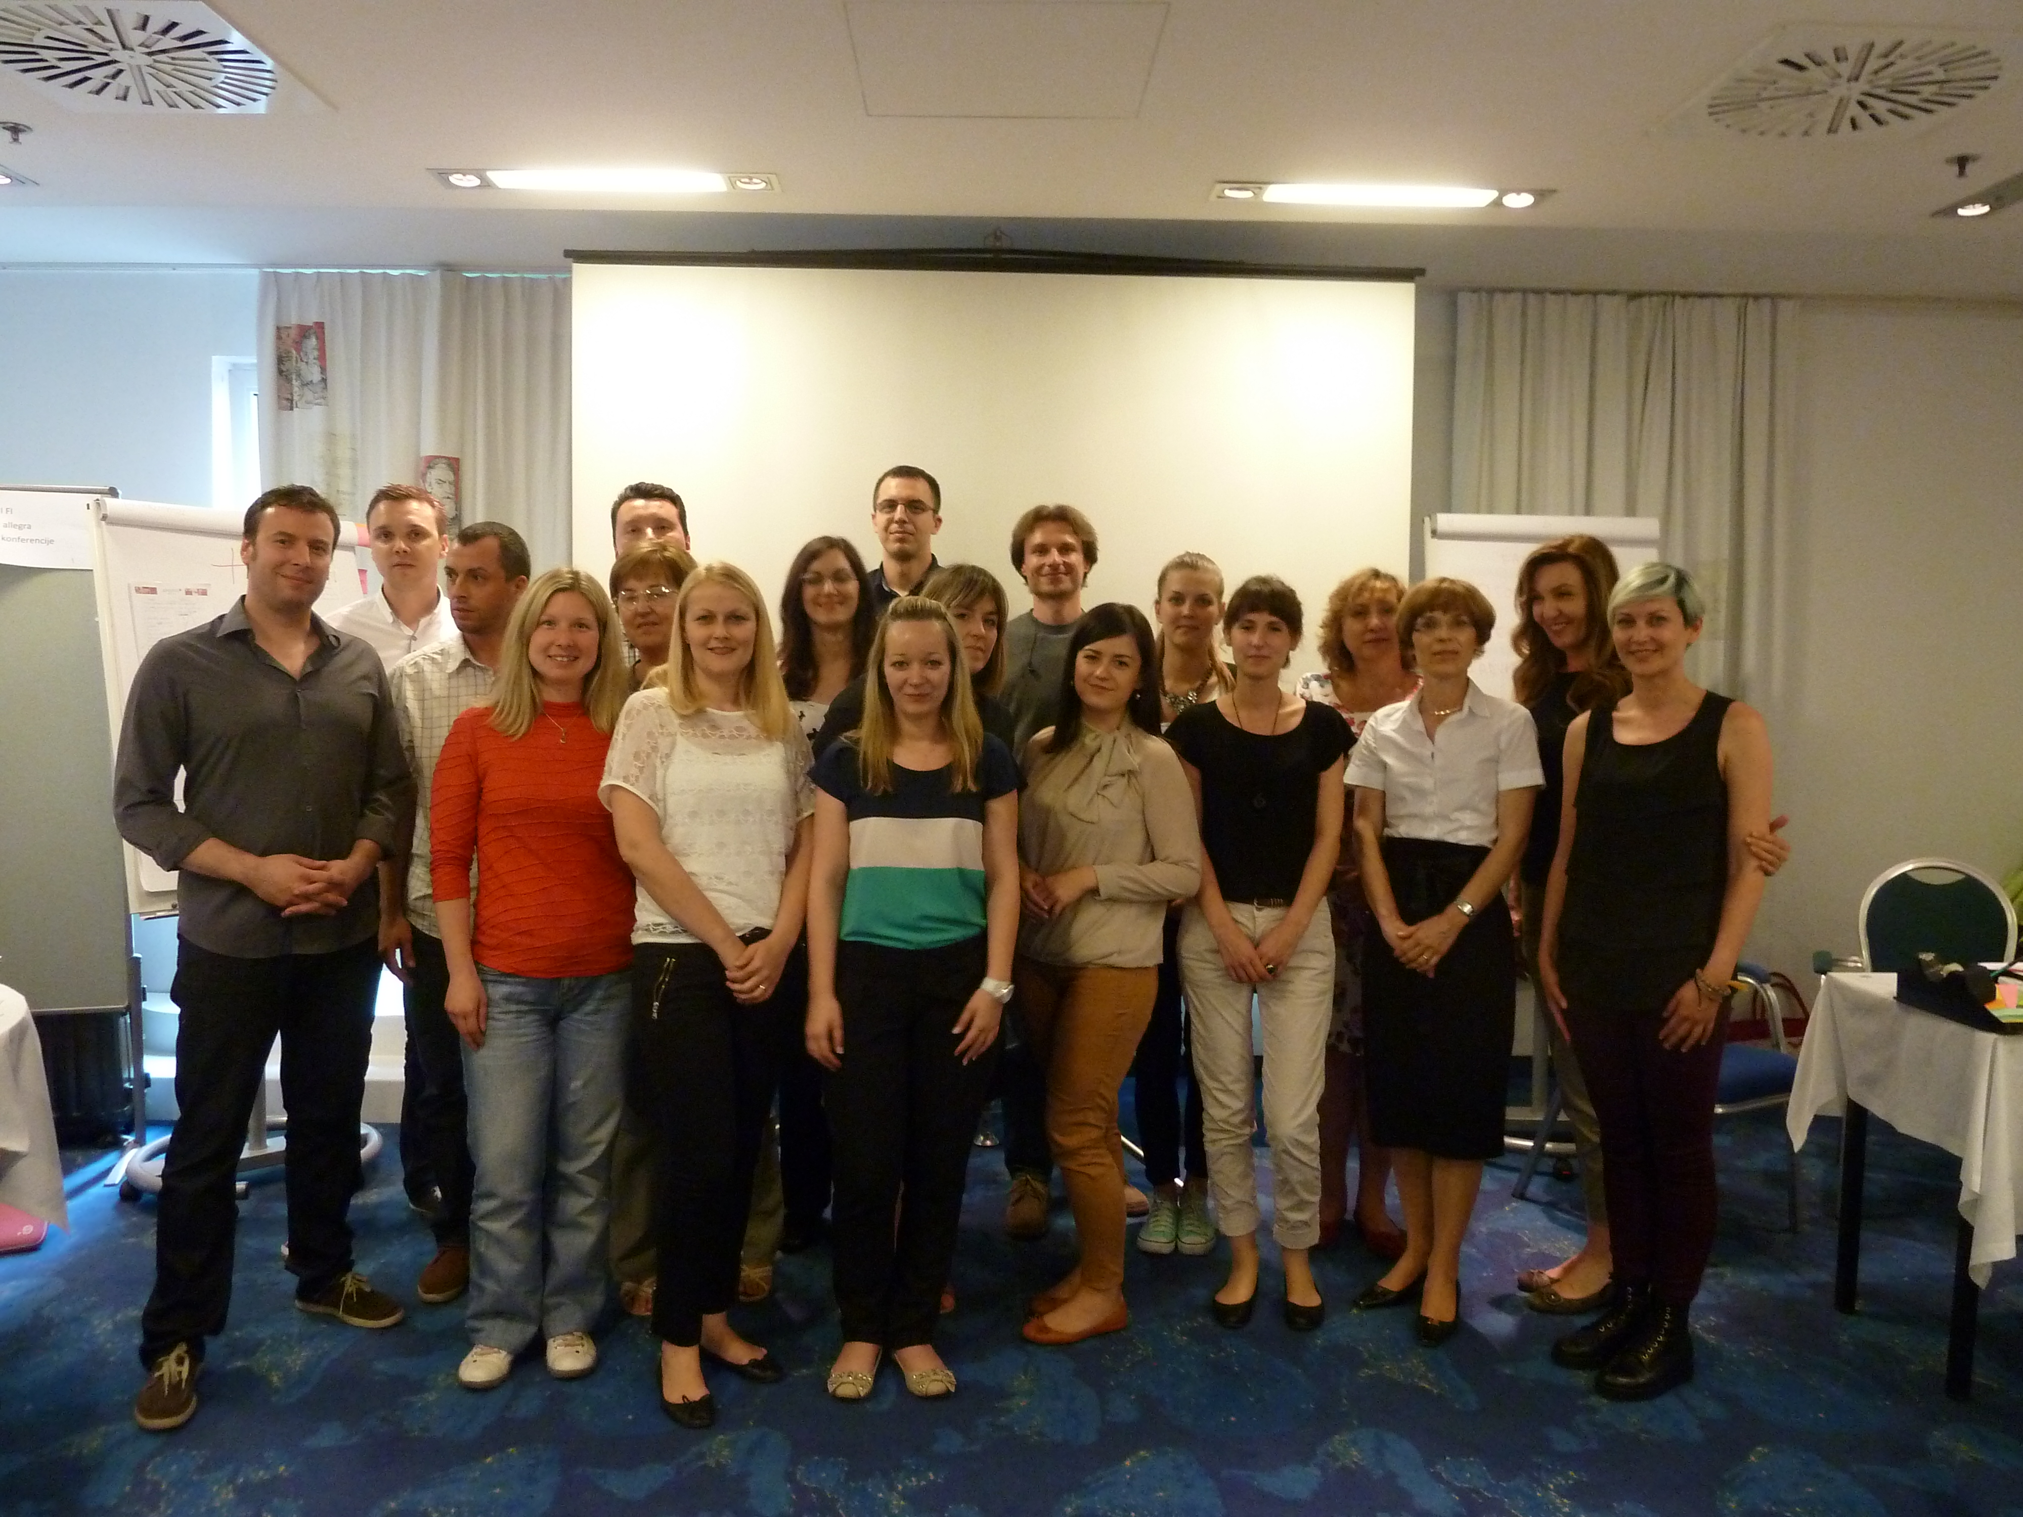
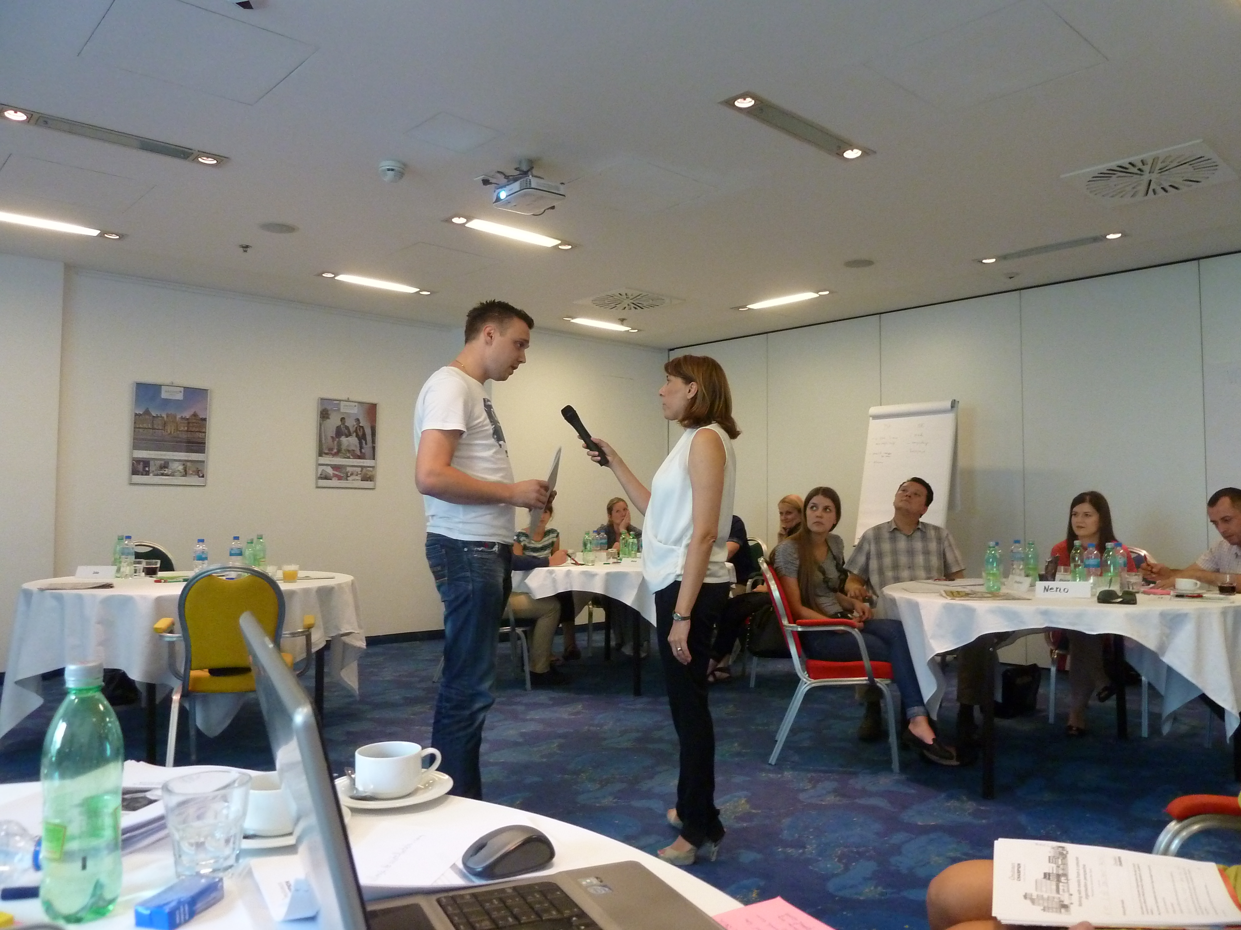
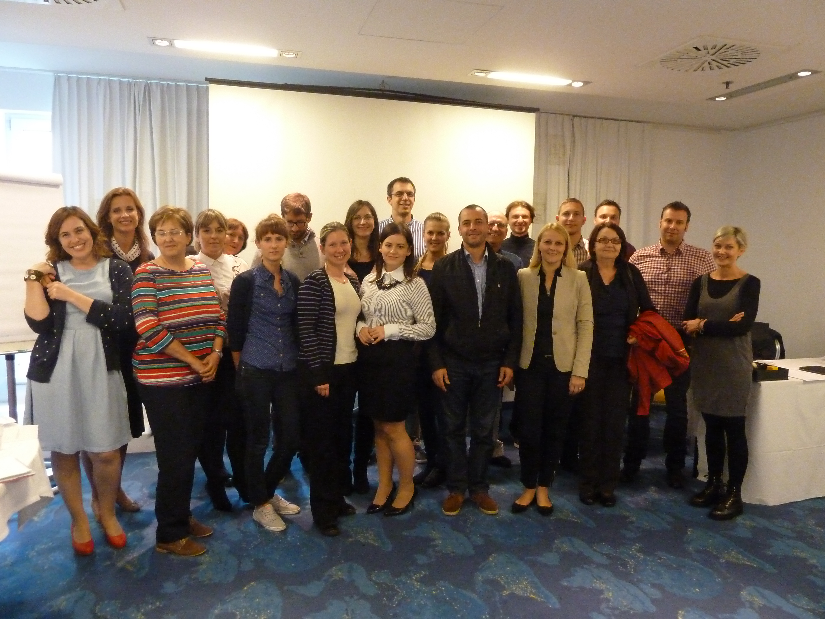
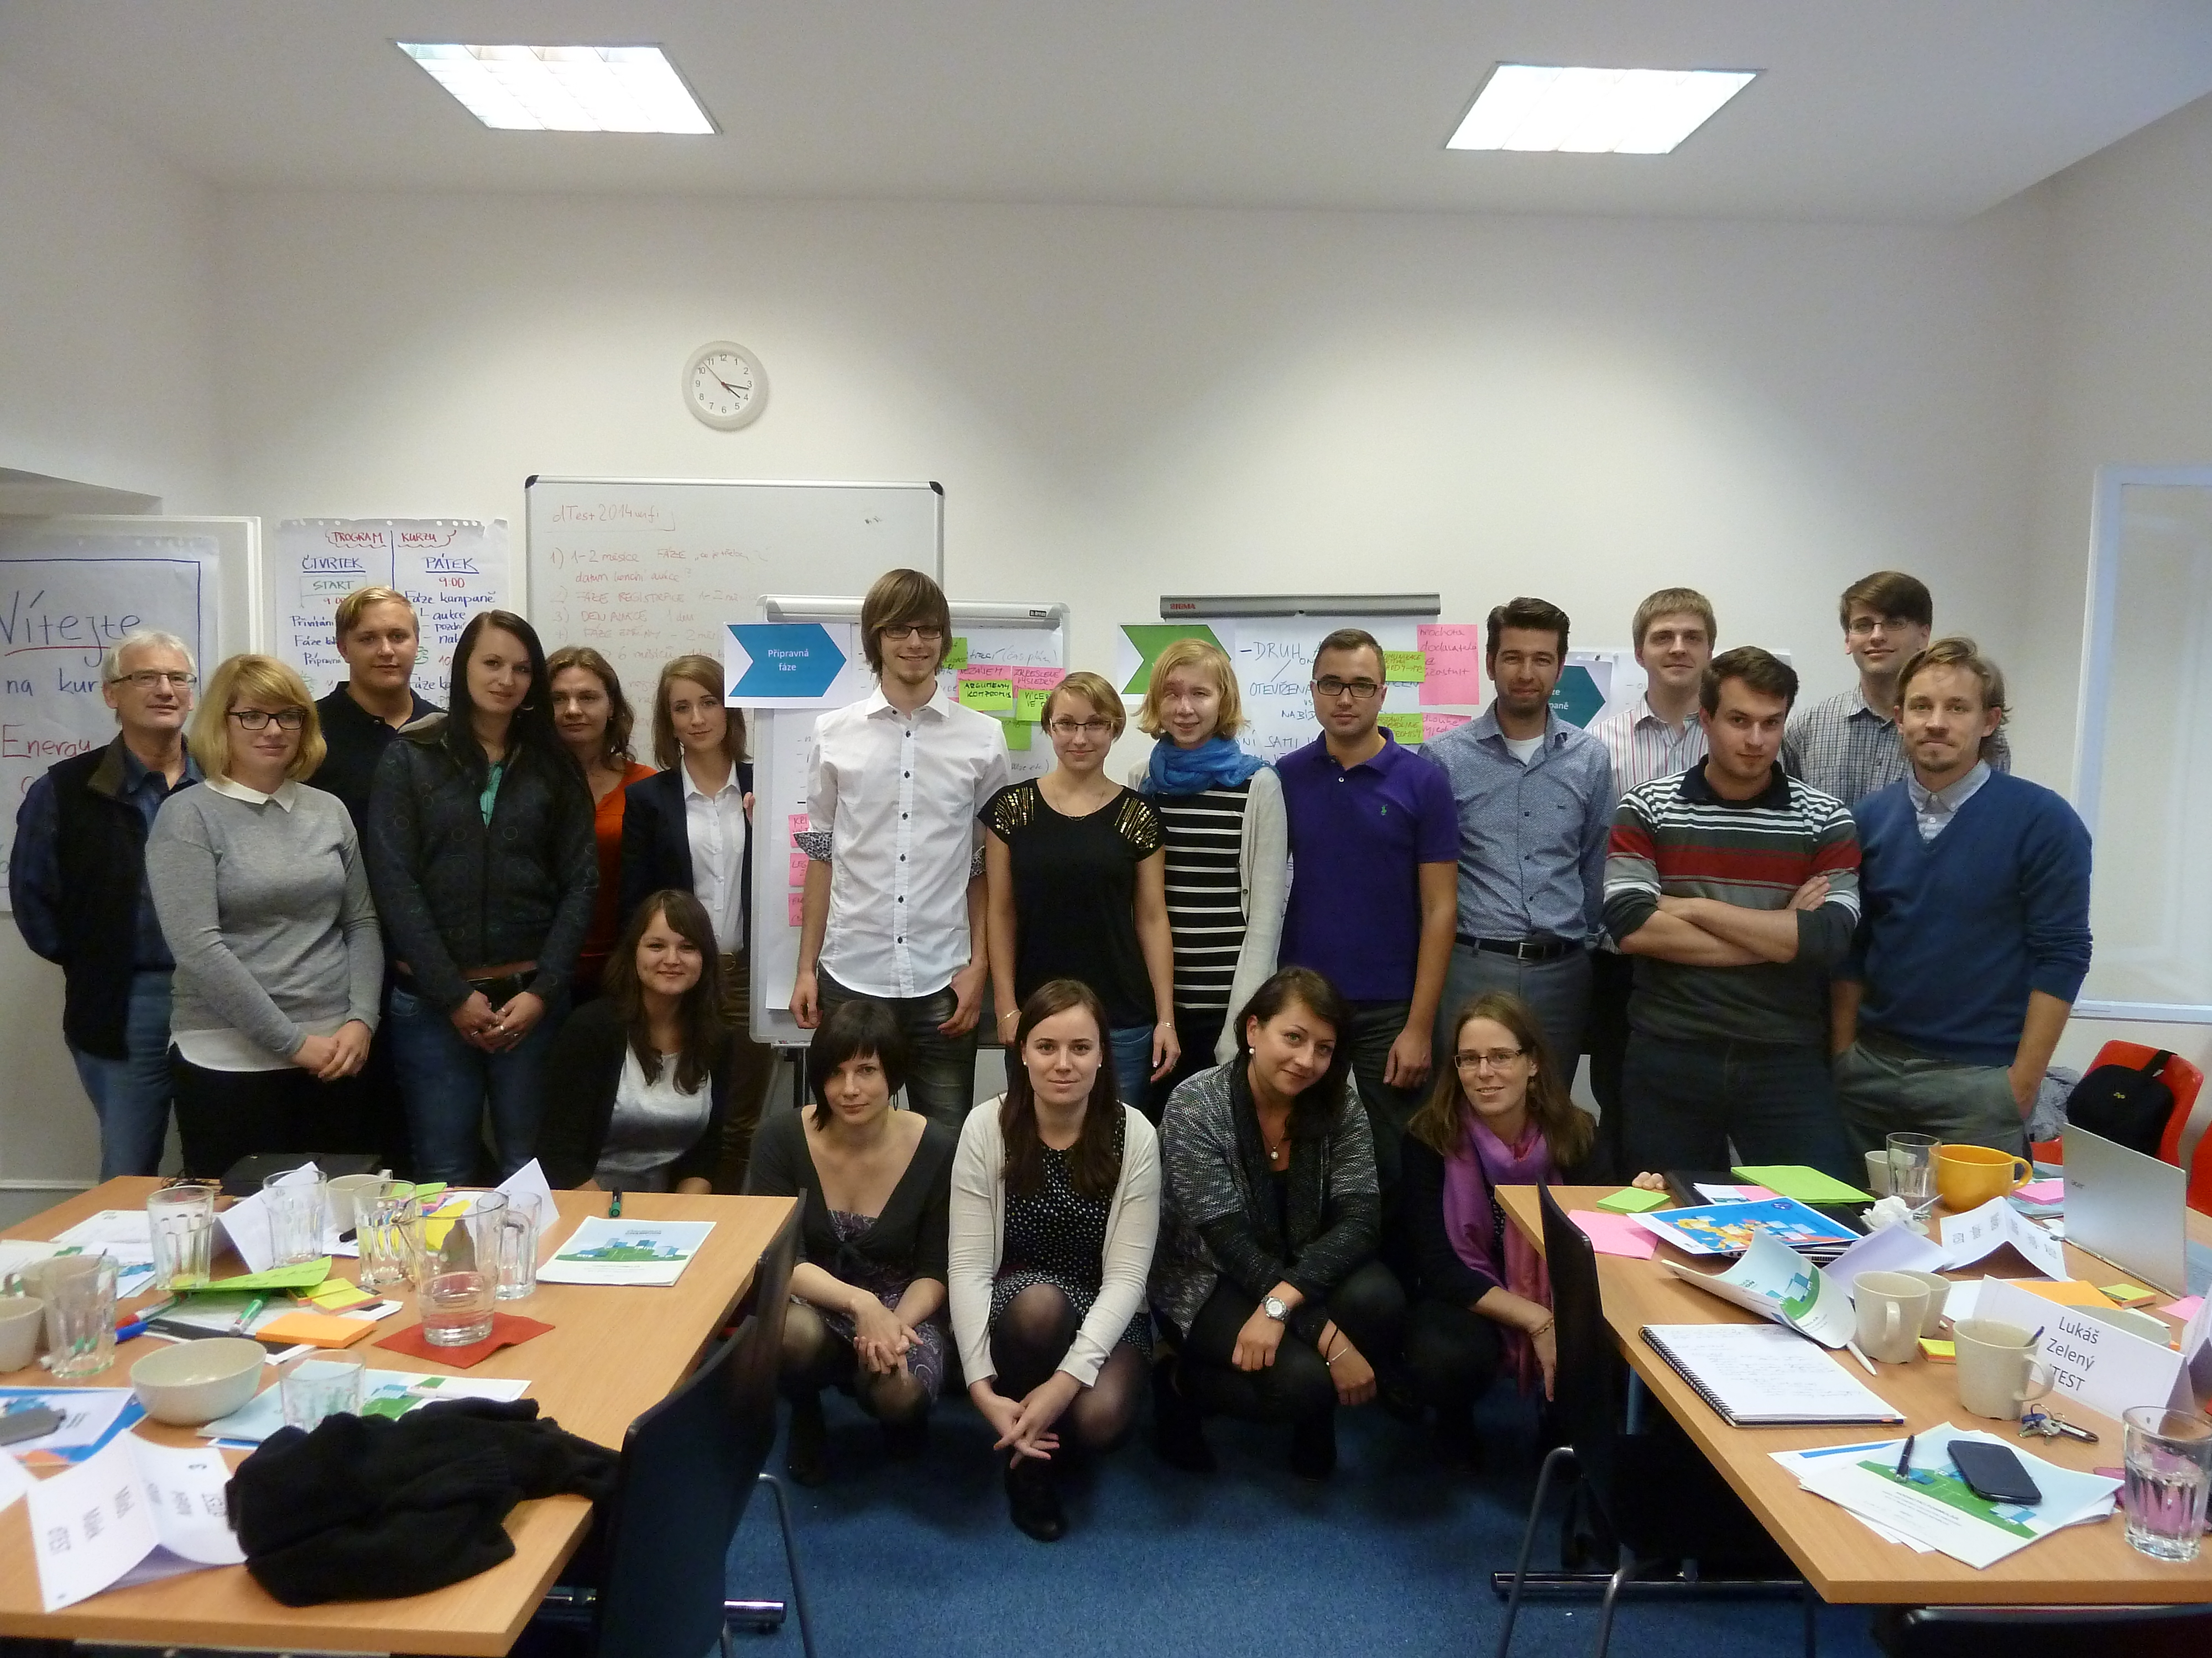
Local Courses Completed
23 & 24 June 2014
HR1: CONSUMER ADVICE
Essential skills for and Professionalisation of Consumer Advice
16, 17 & 18 July 2014
HR2: WORKING WITH MEDIA
25 & 26 Sept 2014
HR3: CONSUMER LAW
EU legislation and Croatian Consumer law
16 & 17 October 2014
CZ1: ENERGY COLLECTIVE SWITCHING
6 & 7 November 2014
PL1: ENERGY COLLECTIVE SWITCHING

Slide 19
Participants’ testimonials
Dunja Mak - HR1 – Consumer Advice:
“Thank you for the nice and really valuable training. I will definitely apply the knowledge received. In addition, I am happy for pictures and presentations received and I definitely visit the website.”
Dunja Mak and Dinko Mihaljevic - HR2 – Working with Media:
« My colleague Dinko and I keep action plans in our office and we are already implementing some of the listed activities in order to achieve an even higher level of professionalism and to spread acquired knowledge. We would also like to thank you for such an interesting and educational course.”
Lenka Vasilova - CZ1 – Energy Collective Switching:
« On behalf of Ministry of Industry and Trade, I would like to thank you for the invitation. It was very interesting experience and the team of trainers and organisers was just great. Indeed, it has been two demanding course days, but it definitely worth it. »
Vladimir Cerny - CZ1 – Energy Collective Switching:
“Thanks a lot for everything, I would be happy to use the pictures sent for my article in our internal bulletin (my action plan task no. 2).
I am looking forward to next trainings and meetings with organisers“

Slide 20
Next steps
03

Slide 21
Next Steps
WEB NETWORKING PLATFORM: COMING SOON Add new features, content and improvements
E-LEARNING Develop new courses and add further translations
TRAINING More courses to be announced
Notes:
Insert LIVE DATE when available

Slide 22
What can you do to help
When the site goes live, please visit & create your account
Contribute to the Forums and help us to grow our online consumer community
Tell others who might be interested

