Slide 1
Consumer Policy of the Austrian Chamber of Labour
ECCG
March 2014
Gabriele Zgubic Austrian Chamber of Labour

Slide 2
Main non governmental consumer organisations in Austria: - Austrian Chamber of Labour - Austrian Consumer Association Special issues organisations e.g.: - Motorists Association - Tenant organisations - Credit counseling and debtor education
ECCG
March 2014
Gabriele Zgubic
Austrian Chamber of Labour

Slide 3
Alternative Dispute Resolution Bodies: Special issues organisations established by the industry, by law or public entities eg: patient rights, telecom, railroad, air passenger rights, housing, energy, dentists, used cars, internet, dating- and marriage agencies New: Model ADR Body - currently financed by the ministry of social affairs, financial participation of the Chamber of Labour very likely
ECCG
March 2014
Gabriele Zgubic
Austrian Chamber of Labour

Slide 4
ECCG
March 2014
Main governmental responsibility
- Ministry of Social Affairs
- Ministry of Justice
Gabriele Zgubic
Austrian Chamber of Labour

Slide 5
Austrian Chamber of Labour The Federal Chamber of Labour represents together with the nine Chambers of Labour in each Austrian province the interests of 3.4 million employees and consumers in Austria All employees are subject to compulsory membership The Austrian Chamber of Labour is part of the Austrian social partnership – together with the Austrian Trade Union, Austrian Chamber of Commerce and Chamber of Agriculture
ECCG
March 2014
Gabriele Zgubic
Austrian Chamber of Labour

Slide 6
ECCG
March 2014
Main tasks
Fundamental research for the benefit of our members
Representation of the interests of our members in certain political fields
Evaluation of draft legislation, making proposals for amendments and subsequently involvement in the implementation of these laws
Services
Office in Brussels
Gabriele Zgubic
Austrian Chamber of Labour

Slide 7
Consumer policy Advices p.a. ca 400.000 Consumer policy activities together with stakeholders, events, publication of position papers and opinions, participation in ministerial working groups in case of proposed new legislation, cooperation with BEUC Information, sample letters, studies, brochures, youtube clips, apps, comparison tools eg for banking services, telecom provider and PR activities
ECCG
March 2014
Gabriele Zgubic
Austrian Chamber of Labour

Slide 8
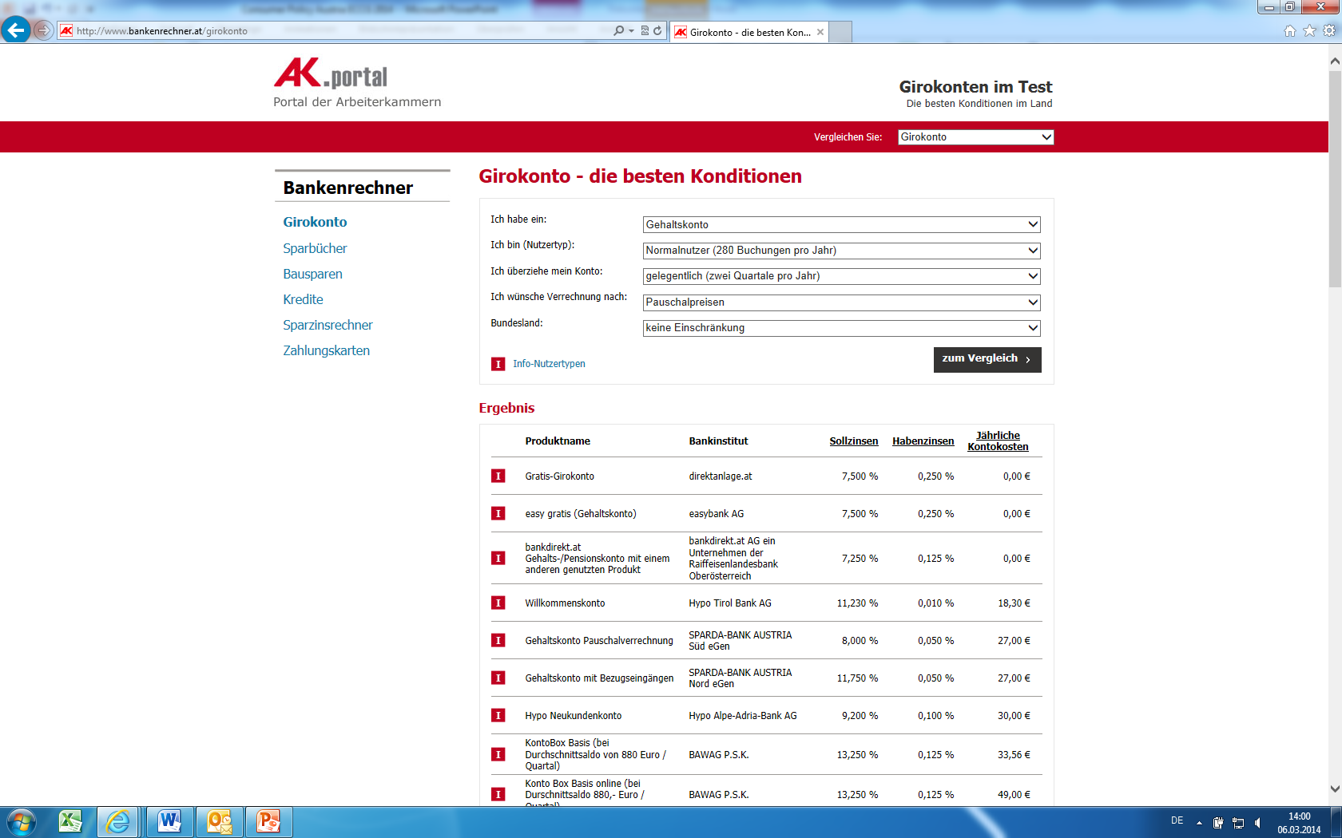
ECCG
March 2014
Comparison tool bank giro account
Gabriele Zgubic
Austrian Chamber of Labour

Slide 9
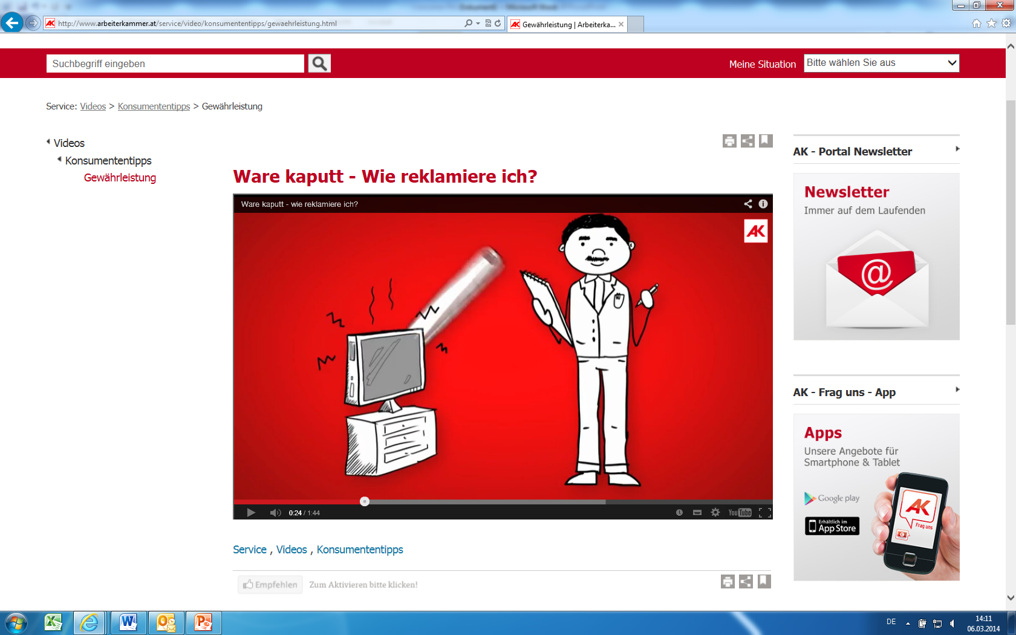
ECCG
March 2014
Youtube clip guarantee
Gabriele Zgubic
Austrian Chamber of Labour

Slide 10
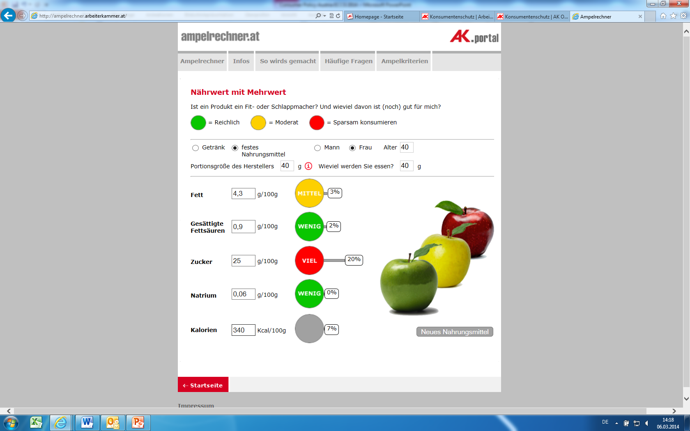
ECCG
March 2014
Traffic light for food – cereals for breakfast
Gabriele Zgubic
Austrian Chamber of Labour

Slide 11
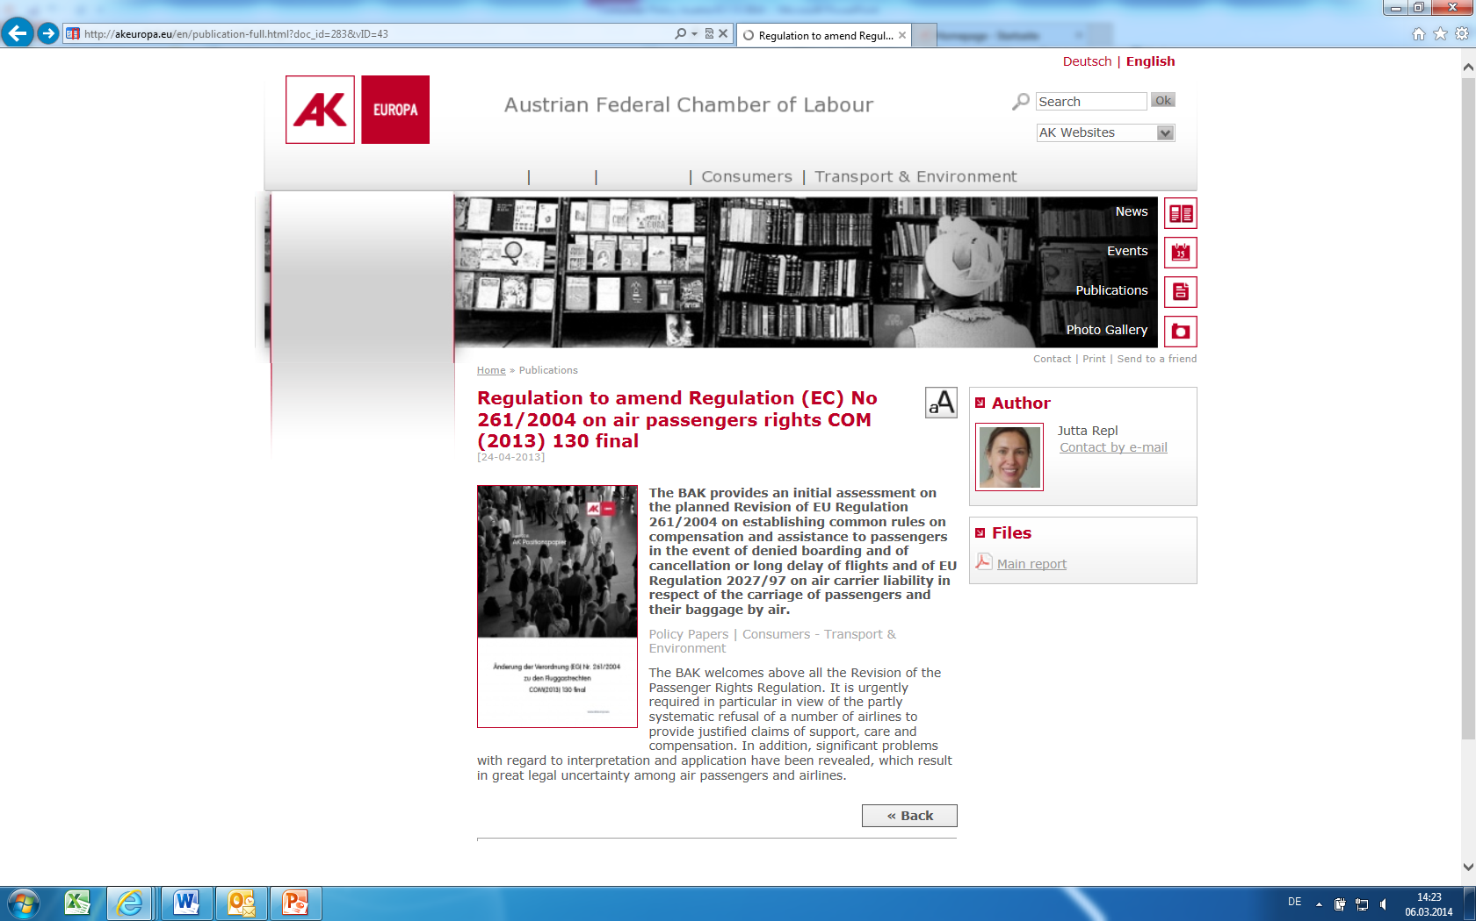
ECCG
March 2014
www.akeuropa.eu: Position paper air passengers rights
Gabriele Zgubic
Austrian Chamber of Labour

Slide 12
Consumer policy Legal assistance ranging from interventions to free representation of consumers in court Group action against unfair contract terms and violation of the law against unfair competition Market and price surveillance Member (and substantial financier) of the Austrian Consumer Association; chair of the supervisory board
ECCG
March 2014
Gabriele Zgubic
Austrian Chamber of Labour

Slide 13
Main Activities 2013/14 Conference on planned obsolescence in June 2013 About 50 studies and price comparisons eg prices for food and drugstore products, telecom charges, analysis of KIIDs for investment funds, monitoring of banking fees, interest rates for savings accounts and cost of loans, rental fees Publication of the „Report on the situation of consumers 2011/12“ together with the Austrian Consumer Association Campaign against high rental fees for residences; ia online questionnaire („Check your rental fee“); opinion survey regarding burden of the cost of renting for young employees, signature campaign, intensive PR activities – aim: limitation of rental fees
ECCG
March 2014
Gabriele Zgubic
Austrian Chamber of Labour

Slide 14
Main Activities 2013/14 Collecting claims of investors of corporate bonds issued by an Austrian construction firm which got bankrupt – about 800 retail investors are participating Active participation in new legislation process at national and EU level – eg CESL, PRIPS, IMD II, PSD, data protection, air passenger rights, package holidays, implementation of Consumer Rights Directive, ADR Implementation of the programme of the new Austrian government regarding consumer protection ia dedication of penalties imposed by the antitrust court in favour of Austrian Consumer Assocation
ECCG
March 2014
Gabriele Zgubic
Austrian Chamber of Labour

Slide 15
What we do not : product tests Austrian Consumer Assocation magazine „Konsument“
ECCG
March 2014
Gabriele Zgubic
Austrian Chamber of Labour

Slide 16
Success and influence of consumer organisations depends on the political environment, commitment, expertise, creativity and – essential – ressources Therefore also for consumer organisations a principle applies: Money counts
ECCG
March 2014
Gabriele Zgubic
Austrian Chamber of Labour

Slide 17
Thank you for your attention
ECCG
March 2014
Gabriele Zgubic
Austrian Chamber of Labour

