Slide 1
Consumer Redress actions taken by
Public Authorities
Priority trends of the consumer protection in the EU:
Consumer redress
3-4 October 2013
Vilnius
Henrik Øe
Consumer Ombudsman
Denmark
4 October 2013

Slide 2
Agenda
Consumer protection landscape
Enforcement of consumer protection at national level
ADR: Advantages and disadvantages
The role of the Consumer Ombudsman and enforcement instruments
Advantages of effective collective redress schemes
Linking private group actions with actions taken by the Consumer Ombudsman
Summing up
Questions

Slide 3
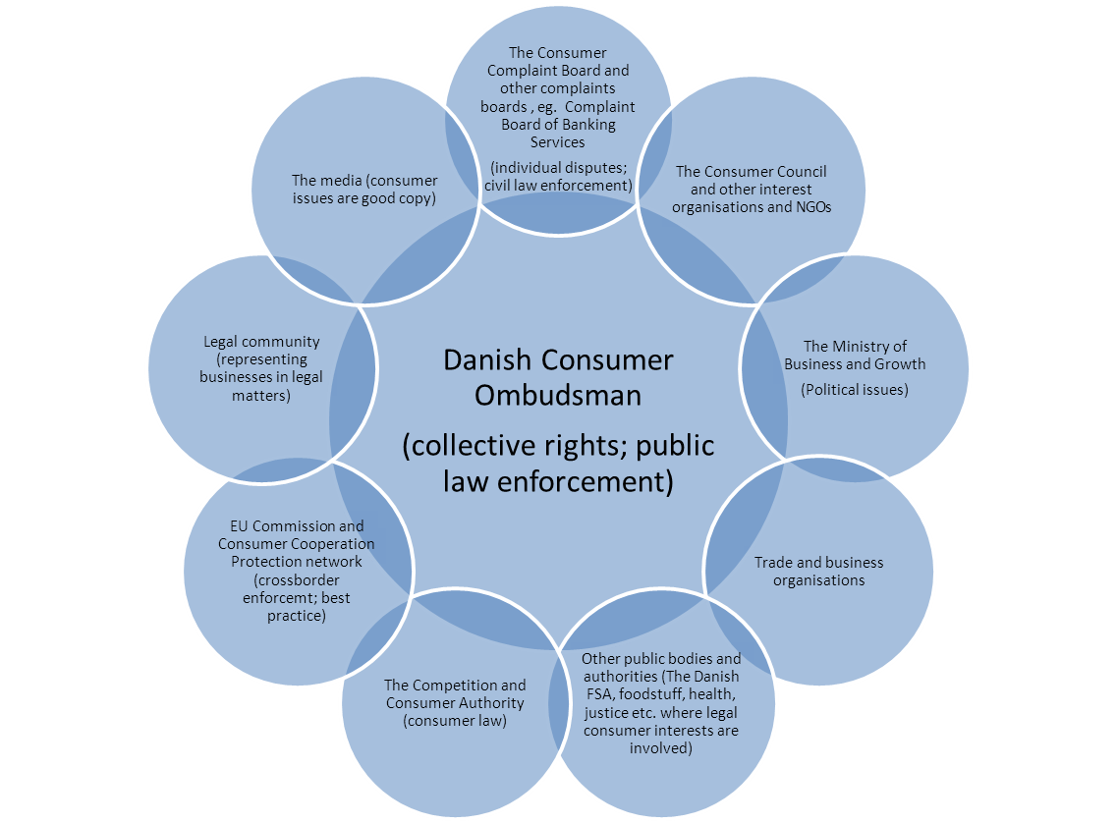
Consumer protection landscape

Slide 4
Enforcement of consumer protection law at national level
Remedies available to the consumers (individual or collective redress)
  Complaint boards (ADR) – if the claim exceeds DKK 800 ( EUR 120)
  Individual civil action in courts (small claims procedure)
  Complaint to the Consumer Ombudsman
  ……
  The Consumer Council voices consumer concerns
  The media

Slide 5
ADR: Advantages and disadvantages
Advantages:
Informal, quick and inexpensive (maybe not for companies)
Most decisions are followed
Disadvantages:
Decisions are not directly enforceable
Often not possible to produce evidence (e.g. witness statements) – subsequent court procedure may be necessary
Possible solutions:
    The decision is enforceable by default if the trader does not inform the ADR board that the decision will not be followed
    Free legal aid to consumers to continue in courts
    ‘Name and shame’
    Decision could be binding according to prior agreement
However: Case by case solutions only

Slide 6
The role of the Consumer Ombudsman as a public enforcer
‘Hard’ law enforcement in cases of more general interest:
  Administrative orders
  Information about limitation period order
  Interim injunctions
  Injunction or court orders
  Civil lawsuit for i.a. compensation to consumers
  Collective redress (opt in or opt out model)
  Supplements ADRs
  Criminal proceedings
  Administrative fines

Slide 7
The role of the Consumer Ombudsman as a public enforcer
‘Soft’ law approaches
Negotiations with the company or industry generally result in:
Settlements
Section 23 of the Danish Marketing Practices Act:
‘The Consumer Ombudsman shall seek by negotiation to influence traders to act in accordance with the principles of good marketing practices and to observe this Act in other respects’
  Guidelines or guidance papers (allows the industry to influence how the law is interpreted, a result of which is joint ‘ownership’)
Section 24 of the Danish Marketing Practices Act:
‘Upon negotiation the DCO will seek to influence the conduct of traders by the preparation and issue of guidelines for marketing in specified areas that must be considered essential, especially in the interests of the consumer’

Slide 8
Benefits from effective collective redress schemes
  Small and founded claims are not necessarily left unpursued
  Improvement of consumer confidence
  More equal and fair competition
  Sufficient safeguards in the Danish legislation to avoid unfounded claims
  Court approval
  ‘Loser pays’ principle
  No punitive damages
  Two models are necessary:
  Traditional opt in model (group representative)
  Opt out model (if the individual claim is less than EUR 270) – can only be used by public authority (DCO)
  Although not yet used in courts it is an effective tool when negotiating settlements
  The threshold should, however, be increased

Slide 9
Linking private group actions with actions taken by the Consumer Ombudsman
A private group action and test cases by the Consumer Ombudsman
A private group action in which the Consumer Ombudsman intervenes
Settlements initiated by the Consumer Ombudsman which also include participants in a private group action but without prejudice to individual lawsuits
  Advantages:
    Cost effective
    Makes individual lawsuits more unlikely

Slide 10
Examples
  In courts (private enforcement)
  Bank Trelleborg (redemption of minority shareholders)
  Løkken Savings Bank (compensation of guarantors who lost guarantee capital)
  Jyske Bank (risky investment product that lost most of its value)
  Sampension (pension fund’s withdrawal of ‘payment guarantee’ with retroactive effect)
  In settlements (with the Consumer Ombudsman)
  BasisBank (unlawful increase of interest rates)
  Tyrkiet Eksperten (travel agency flying passengers to the wrong airport)
  Sampension (settlement)
  DiBa Bank (judgment in the Supreme Court and settlement)
  Jyske Bank (DCO test cases)

Slide 11
To sum up
Unfair commercial practises should not pay off or be supported by ineffective legislation
The Consumer Ombudsman, the ADRs and small claims procedure constitute a robust setup that counters these practises
How to ensure that Consumer Ombudsman activities
  have a real impact
Dialogue and negotiation are efficient tools when supported by enforcement remedies
Guidelines and guidance papers contribute to building effective markets because they create a level ground for fair competition – and because business knows that enforcement may be used in case of non-compliance
Collective redress schemes ensure that founded small claims are not left unpursued – and they facilitate settlement which also often solves private lawsuits

Slide 12
Questions and comments
Thank you for your attention!
Henrik Øe
Danish Consumer Ombudsman
www.consumerombudsman.dk

