Slide 1
Capacity Building Actions for European Consumer Organisations
Presented by Monique Goyens
Notes:
New programme Capacity Building for European Consumer Organisations funded by the EU budget and carried out by a consortium of three partners. As a follow-up of the former successful TRACE programme, it takes capacity building to the next level with a broader approach.
Having started our work on the project in January 2014, I am pleased to present you today the first results of our common work and collaboration.
I will start with a short overview of the who and what of the programme and then present you then the brand name, our logo and an idea of the website you can expect soon. I will finish telling you where we are at the moment and what you can look forward to in terms of training, community and resources.
New programme Capacity Building for European Consumer Organisations funded by the EU budget and carried out by a consortium of three partners. As a follow-up of the former successful TRACE programme, it takes capacity building to the next level with a broader approach.
Having started our work on the project in January 2014, I am pleased to present you today the first results of our common work and collaboration.
I will start with a short overview of the who and what of the programme and then present you then the brand name, our logo and an idea of the website you can expect soon. I will finish telling you where we are at the moment and what you can look forward to in terms of training, community and resources.
New programme Capacity Building for European Consumer Organisations funded by the EU budget and carried out by a consortium of three partners. As a follow-up of the former successful TRACE programme, it takes capacity building to the next level with a broader approach.
Having started our work on the project in January 2014, I am pleased to present you today the first results of our common work and collaboration.
I will start with a short overview of the who and what of the programme and then present you then the brand name, our logo and an idea of the website you can expect soon. I will finish telling you where we are at the moment and what you can look forward to in terms of training, community and resources.
New programme Capacity Building for European Consumer Organisations funded by the EU budget and carried out by a consortium of three partners. As a follow-up of the former successful TRACE programme, it takes capacity building to the next level with a broader approach.
Having started our work on the project in January 2014, I am pleased to present you today the first results of our common work and collaboration.
I will start with a short overview of the who and what of the programme and then present you then the brand name, our logo and an idea of the website you can expect soon. I will finish telling you where we are at the moment and what you can look forward to in terms of training, community and resources.

Slide 2
Overview
01

Slide 3
The Team
European Commission
CHAFEA (Consumers, Health and Food Executive Agency) former EAHC
DG SANCO
Consortium
BEUC Brussels = Project Leader (Content/training methodology)
SIVECO Romania = Project Partner (e-Learning and web platform)
Dara Creative Ireland = Subcontractor Siveco (Branding and web design)
Notes:
The consortium represents strong partners with the right mix of expertise
Close collaboration with the European Commission to develop the tools together

Slide 4
The Programme
Framework Service contract 2013 - 2017
Objective:
Building capacity and effectiveness of COs and other actors and stakeholders in consumer policy
Promoting exchange and networking
Focus on Central, Eastern and South Eastern European countries-CESEE
5 Activities
Notes:
Framework Service Contract 2013 – 2017 to provide training for building capacity and effectiveness of consumer organisations (incl. other actors and stakeholders in consumer policy) and to promote exchange of practices between their staff members as well as strengthen and increase networking.
Special attention will be granted to COs based in EU Member States, EEA and candidate countries where the consumer movement is not sufficiently developed and/or influential.
Programme is divided into 5 complementary activities which are heavily interlinked and will integrated in the Consumer Classroom (synergy effect) > SEE NEXT PAGE

Slide 5
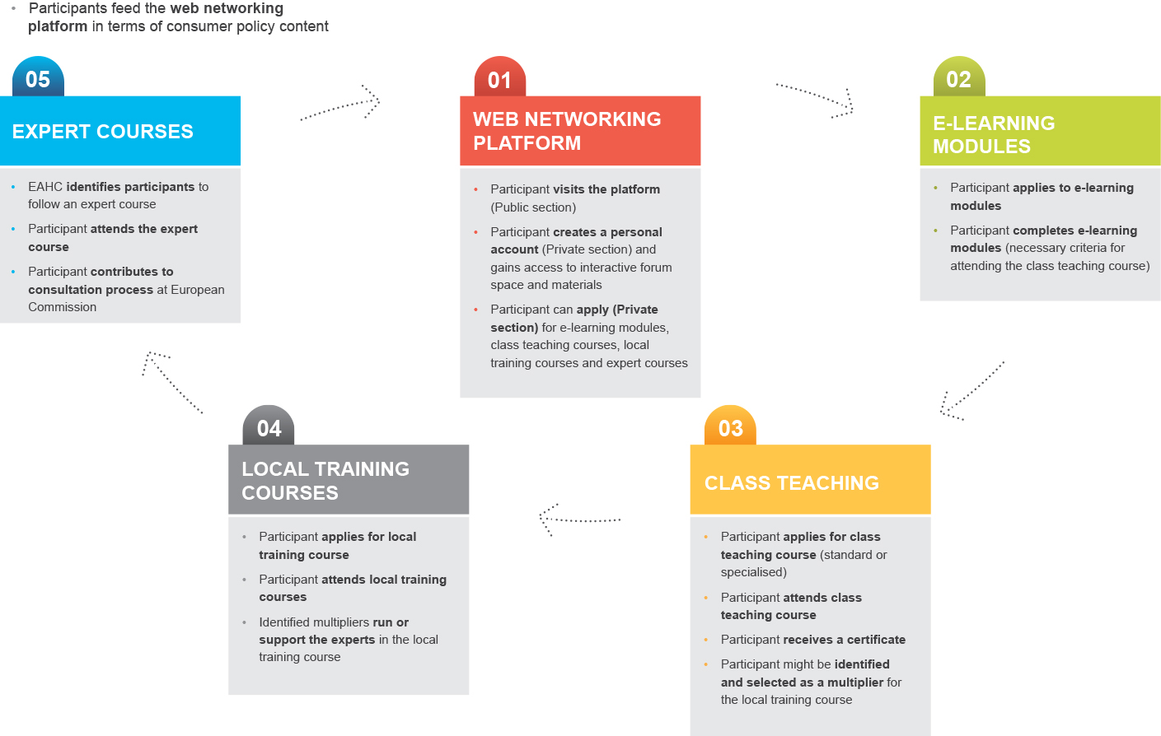
The Tools
Notes:
Cross-fertilisation between different capacity building tools and activities: The programme provides a pathway through the different activity levels where participants, tutors/trainers and experts of all levels could add to the synergy effects between the different activities. Web network platform for information and exchange, possibility to train oneself with e-learning modules, attend tailor-made class teaching courses in Brussels, where we also identify mulitpliers who in turn can run courses or support experts in local training. Special courses for a small number of identified experts who are trained via tailored programmes to contribute to consultation processes and participants, trainers, multipliers, experts, COs feeding again into the web networking platform with content, news etc.

Slide 6
Name & Logo
02

Slide 7
Capacity Building Actions for European Consumer Organisations
Capacity building
Holistic approach
Alternative tools
Multiple languages
Professional
Interactive
Online
Networking
Notes:
The name for our programme will reflect the capacity building and holistic approach we want to integrate. It includes alternative tools like a web networking platform, e-learning and class teaching. We will provide the content in multiple languages for professionals working in the field to interact with each other and us online and in person to increase networking and thus strengthen the consumer movement. In one word, we will be the consumer CHAMPION

Slide 8
Identity Design
Notes:
Clear synergy with consumer Classroom through the use of a common typeface
The consumer is lifted and supported by the solid foundation of the word champion
The contrast between the two typefaces highlights the strength of the champion.
Using a dark grey background on the applications will further strengthen the link to Consumer Classroom

Slide 9
Sample Applications

Slide 10
Website
03

Slide 11
Web Networking Platform Features
Training
Training guide
Training calendar
Video testimonials
e-learning modules
Physical training courses information
Online application forms
Resources
News section
Social media feed
Events
Expert Advice area
Blog
Q&A
Video workshops
Resource Library
Community
Collaboration and networking area
Members forum,
Members directory
Members instant messaging
Video conferencing guide
Collaborative Projects section
Notes:
@Monique from Brian M.:
It is very difficult to place in here is any type of visual of the web networking platform. To date all we have are the site maps and wireframes. The site map is very detailed and will not replicate or be legible within the constraints of a PPT. As for the wireframes, these are in portrait format and are quite long, to place them into the PPT will mean that they are either very, very small or heavily cropped.
I would suggest that if Monique would like some visuals to accompany these slides that she launch either or both the wire frame and site map PDFs.

Slide 12
What to look forward to in 2014...
04

Slide 13
Schedule
August
Website launch
June
1 e-learning course on consumer Law
Aug – Oct
3 e-learning courses: Energy Consumption, Telecommunication, Financial Services
June - November
3 local training courses
Croatia: Media, EU+Croatia Legislation, Consumer Advice,
Poland/Czech Republic: Collective Energy Switching

Slide 14
Conclusion
05

Slide 15
Consumer Champion: Capacity Building Actions for European Consumer Organisations
New Team
New Tools
New Programme
For a stronger consumer movement in Europe

Slide 16
Thank You!

