Slide 1


"Claudette meets GDPR"
ECCG Meeting
Brussels
23 – 24 October 2018

Slide 2

“Claudette meets GDPR”
Project for “digital enforcement”
BEUC in cooperation with the European University Institute, Florence and the University of Bologna.
Aim of the project
Test the use of Artificial Intelligence for automated scanning and evaluation of privacy policies
Scan of privacy policies of 14 companies to assess compliance with GDPR.
“Claudette”, was trained to detect clauses that potentially failed to meet GDPR requirements.

Slide 3
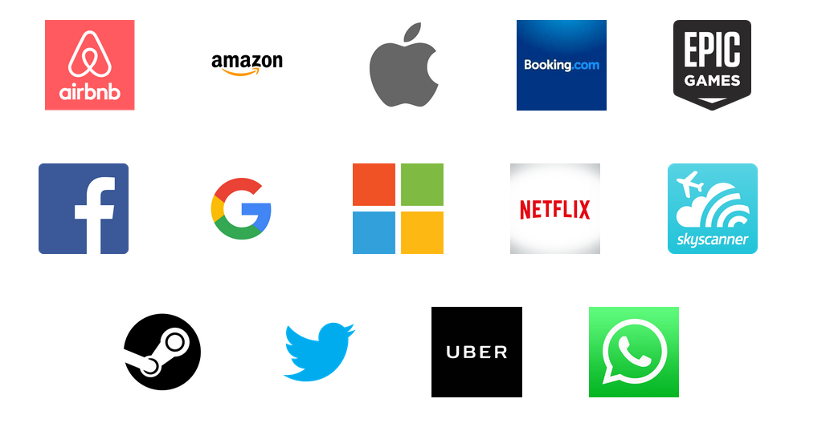
“Claudette meets GDPR”
Which privacy policies?

Slide 4
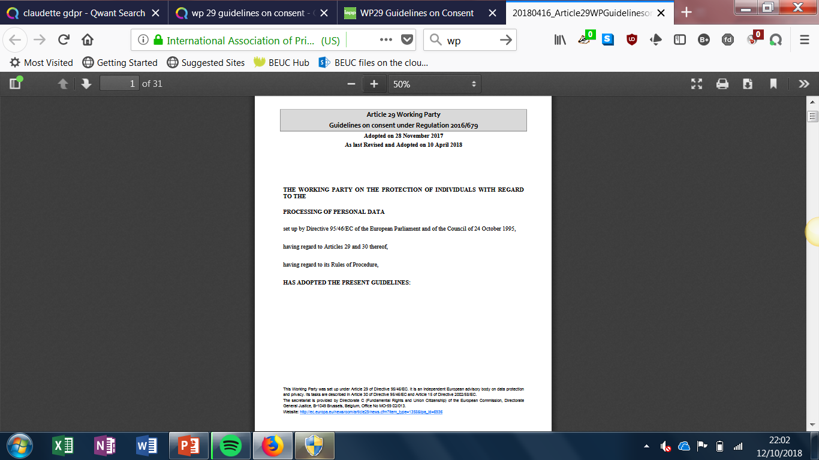
“Claudette meets GDPR”
Methodology
Development of “golden standard” for GDPR-compliant privacy policy using the text of the GDPR and WP29 Guidelines on consent and on transparency
Manual tagging of the text of the privacy policies to train “Claudette”
Automated analysis of content of privacy policies performed by “Claudette”

Slide 5
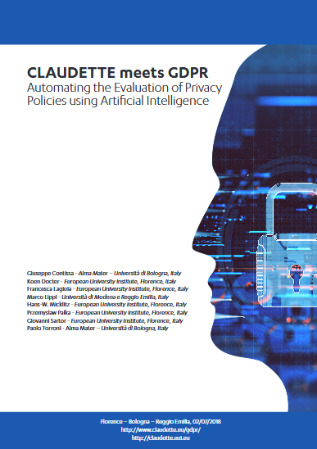
“Claudette meets GDPR”
Results of the project – Published 5th July
Significant need for improvement!
None of the analysed privacy policies fully meets the requirements established by the GDPR.
3,659 sentences (80,398 words) scanned in total:
401 sentences (11.0%) marked as containing unclear language.
1,240 (33.9%) contained “potentially problematic” clauses or clauses providing “insufficient” information.

Slide 6
“Claudette meets GDPR”
Problems identified:
Lack of information. (e.g. no information from companies to users about the third parties with whom they share or get data from.)
Processing personal data in non-GDPR compliant manner . (e.g. clause stating that the user agrees to the company’s privacy policy by simply using its website).
Vague and unclear language (makes it very hard for consumers to understand the actual content of the policy and how their data is used in practice).

Slide 7

“Claudette meets GDPR”
What next?
Aim to develop a long-term project to:
Ensure a better enforcement of consumers' data protection rights using AI.
Develop a tool that can be useful for DPAs, consumer orgs and, ultimately consumers themselves
Next steps:
Exploring options to continue developing “Claudette”.
Using the tool to identify and inform enforcement actions.

Slide 8
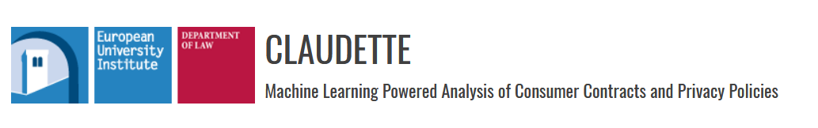
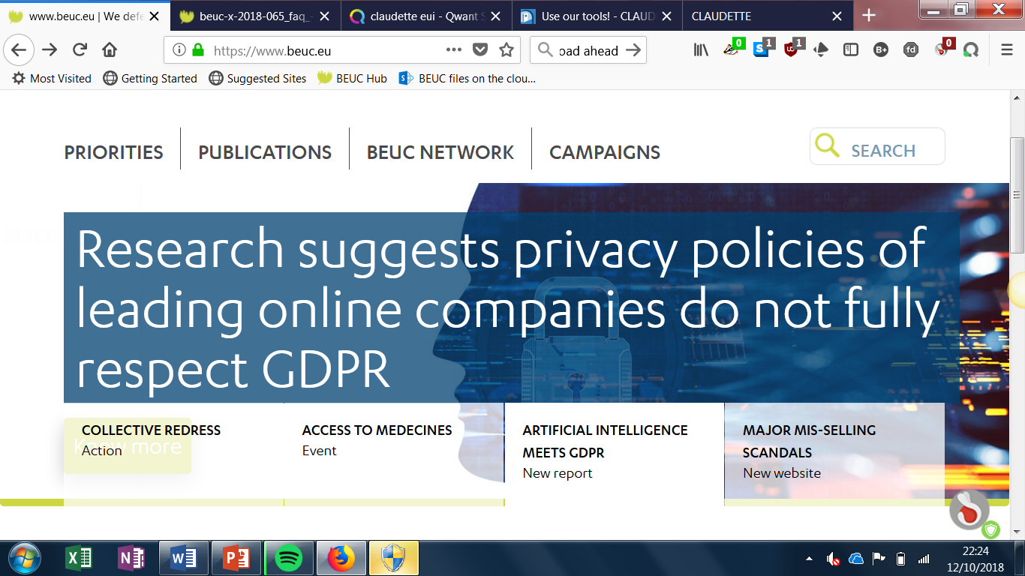
“Claudette meets GDPR”
More information:
https://claudette.eui.eu/
http://www.claudette.eu/gdpr/
https://www.beuc.eu/publications/research-suggests-privacy-policies-leading-online-companies-do-not-fully-respect-gdpr/html
https://www.beuc.eu/publications/beuc-x-2018-065_faq_-_artificial_intelligence_meets_gdpr.pdf
https://www.beuc.eu/publications/beuc-x-2018-066_claudette_meets_gdpr_report.pdf

Slide 9

e
Thank you for your attention
www.beuc.eu
@beuc

