Slide 1
Circular economy
product durability & reparability
planned/premature obsolescence
ECCG meeting 23 October 2018
Jeroen Van Laer
Policy officer Sustainable Consumption
Consumer Policy Unit
Consumers Directorate
DG Justice and Consumers

Slide 2
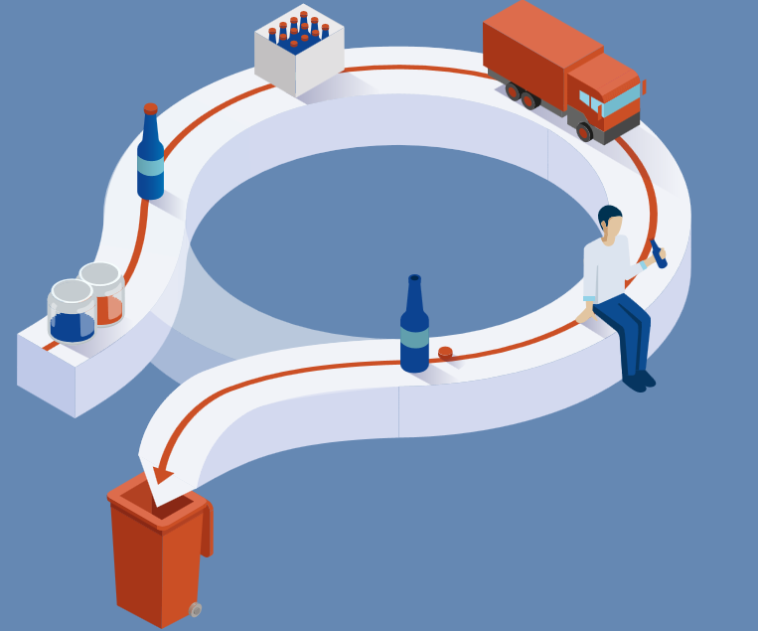
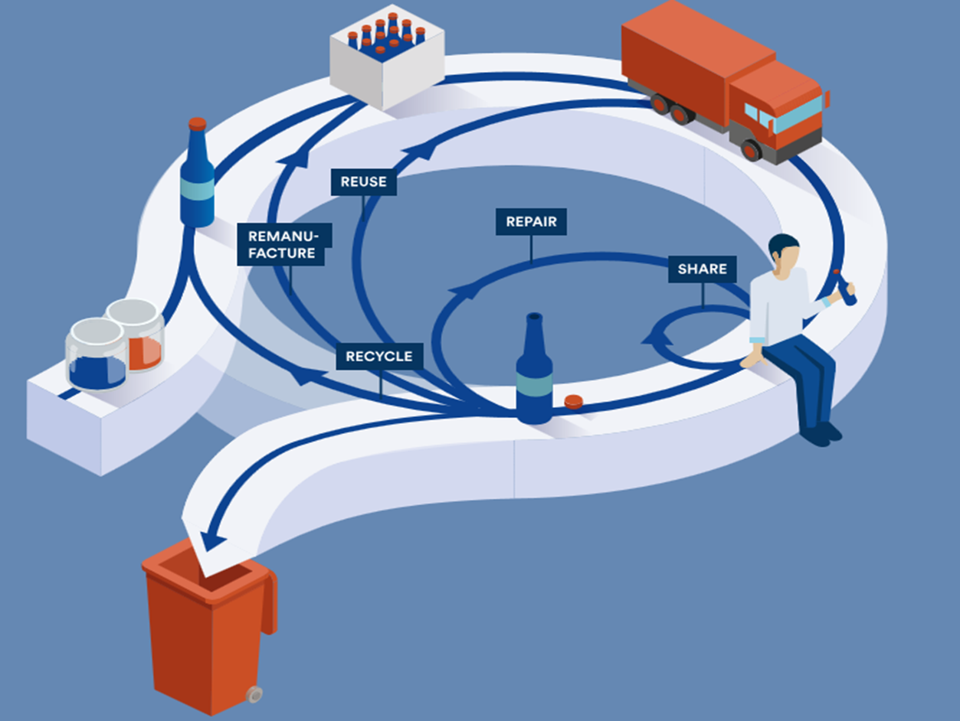
Closing the loop: Circular Economy

Slide 3
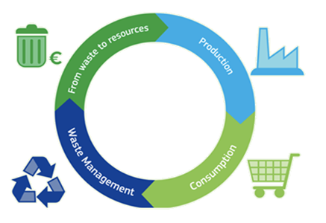
EU Circular Economy Action Plan 2015-2019
54 initiatives covering the whole cycle
4 key areas of Action
> 85%

Slide 4
Ecodesign and Energy labelling – achievements & new challenges
Ecodesign and Energy Labelling - sound policy framework for energy-related products, proved to be highly effective, and brings important benefits to consumers, environment and industry.
More than 40 Ecodesign and Energy Labelling regulations in force, are estimated to deliver, by 2020, annual savings of approximately 9% of the EU primary energy consumption (i.e. almost half of our 20% reduction target and equivalent to the annual primary energy consumption of Italy). Net saving on consumer expenditure is equivalent to around € 490 per household per year.
Working Plan 2016-2019 – to explore the possibility of establishing requirements regarding durability, reparability, upgradeability and design for disassembly, ease of reuse and recycling.

Slide 5
Supporting circular economy via Ecodesign
Not an entirely new concept. However, new approaches needed.
Build on the experience to date, add in new tools and start with the low-hanging fruits/win-win requirements.
Existing requirements: e.g. minimum lifetime of lamps; minimum lifetime of components of vacuum cleaners (motor and hose);
Ecodesign/Energy labelling Package early 2019:
    Refrigeration, washing machines and washer-dryers, dishwashers, electronic displays, etc.
    Examples of new proposed circular economy requirements:
    Availability of spare parts – dishwashers, washing machines, fridges.
    Design for disassembly and repair – dishwashers, washing machines;
    Provision of information facilitating disassembly and repair – dishwashers, washing machines, electronic displays;
    End-of-life / recycling requirements
Also new preparatory studies, e.g. batteries.

Slide 6
Standardisation on material efficiency
Improve the methodological basis for material efficiency requirements in product Regulations
Mandate 543 for standardisation bodies: Developing general standard methods to assess material efficiency aspects of energy related products in support of the implementation of Ecodesign Directive:
- WG2: Durability
- WG3: Reparability, reusability and upgradability
Timing:
  First consolidated drafts in autumn 2017
  WG meetings and public enquiries with national Technical Committees to revise draft standards
  New drafts expected in 2019
  Final horizontal standards in 2020
  More work needed (product-specific) after 2020

Slide 7
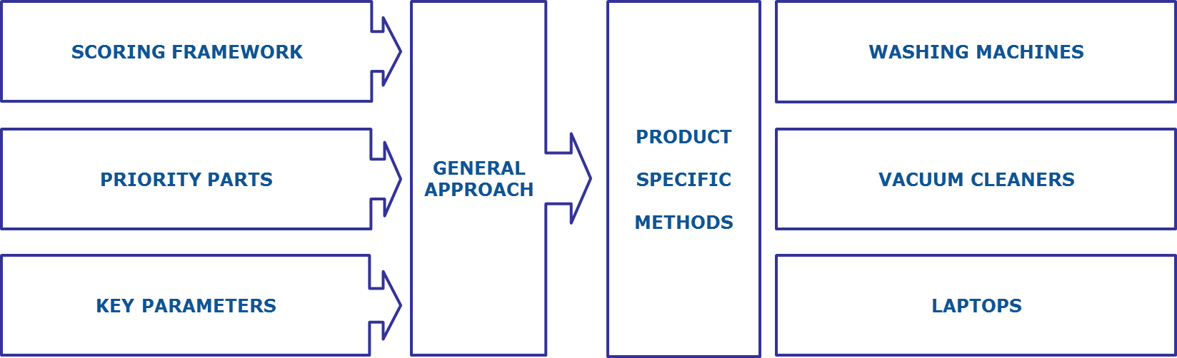
Repair scoring study (next to energy efficiency scoring)
Phase 1: Scoring system for assessing reparability and upgradability of products
Parameters (under revision): ease of access to parts; availability of spare parts; type, number and visibility of fastenings and connectors etc.
Hybrid system = min requirements + rated parameters
Phase 2: ENV's follow-up study to explore development of an information tool (2019)
Phase 1A
Phase 1B

Slide 8
Horizon 2020: Independent testing programme on premature obsolescence
Objective: prepare an independent testing programme to help identify issues related to premature obsolescence.
Focus on a group of consumer products for which the issue of obsolescence, including aspects such as the possibility of repair, upgrade and reuse, is important from the resource efficiency point of view.
Call published in 2017.
Budget: around 5 million euro.
The project is expected to start in 2019 and last 3-4 years, hence the testing programme should be delivered 2022-2023.
It will involve consumers organisations, testing bodies, research centres and manufacturers.

Slide 9



New Deal for Consumers
Protecting consumers (DG JUST)
Proposed 11 April 2018
Objective:
To ensure that all European consumers fully benefit from their rights under Union law
Complementing the EU Circular Economy Action Plan
Stronger enforcement and better opportunities for individual redress against unfair commercial practices and European collective redress right for when groups of consumers have suffered harm
Deterring misleading environmental claims or planned obsolescence practices

Slide 10
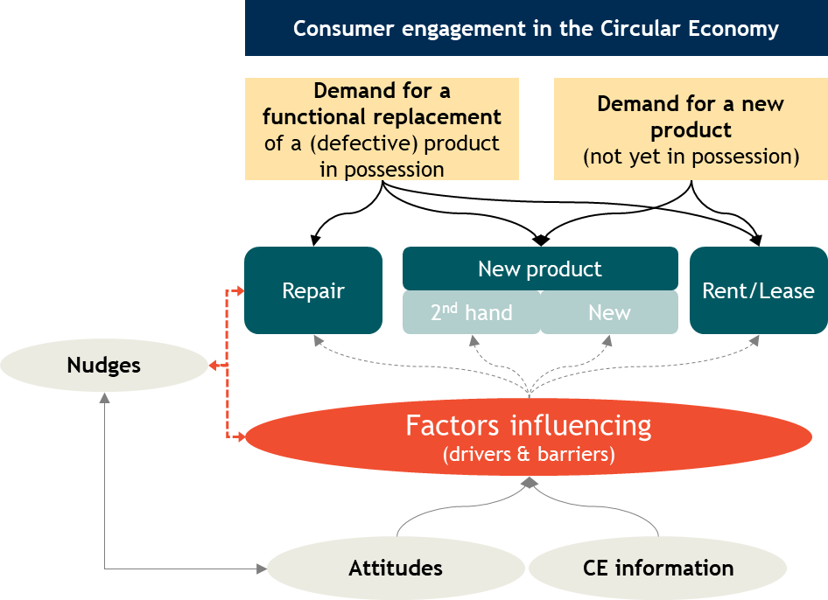
Behavioural study on Consumer Engagement in the Circular Economy (DG JUST)

Slide 11
Consumers claim to be willing to engage in Circular Economy and have high expectations
The majority of survey respondents reported that they keep things they own for a long time (93%), recycle unwanted possessions (78%), and repair possessions if they break (64%).
Respondents also reported that their peers have similar levels of engagement in the Circular Economy.
A lower yet substantial proportion of respondents reported being willing to engage with novel Circular Economy practices such as leasing products or buying second hand products.
  The share of consumers who reported they were interested in leasing varied across product groups: between 10% for vacuum cleaners compared to 25% for mobile phones.
  Overall, around one in three consumers claim to buy second hand products
Many consumers expect products, especially expensive products, to last a long time.
Most consumers expect that repairing products is possible and easy to arrange. Consumers expect a good repair service.

Slide 12
However, consumers’ actual engagement was found to be low
There are still many consumers who have in the past not repaired, leased, rented or bought products second hand.
Most consumers repair products when they break (around 63%).
Yet, the share of consumers who have not repaired products after they broke was still substantial: 36% on average across the analysed products.
  The highest non-repair rate was observed among Dutch survey participants (on average 56%) while the lowest was observed among Romanian participants (on average 25%).
  Age and other socio-demographic factors did not play an important role with respect to repair behaviour.
Professional repair was most popular (26% repair service, 17% manufacturer repairs). Self-repair was less prevalent (~6-18%) except for clothing (24%)
Experience with renting/leasing (1%) and buying second hand (6%) was rather low in the surveyed population.

Slide 13
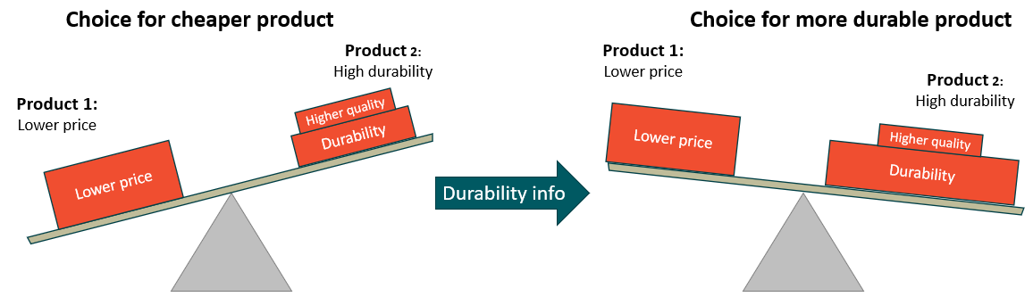
Consumers lack information on product durability and reparability
Results of the behavioural experiment:
Consumers paid attention to durability and reparability information at the point of purchase.
When CE information was provided in the experiment respondents were:
  - Almost 3x more likely to choose highest durability products
  - More than 2x more likely to choose highest reparability products
  - Lowest durability/reparability products became, respectively, widely unpopular

Slide 14
Repair decisions easily disrupted
Many customers try repairing before replacing products, but repair decisions are easily disrupted if arranging repair requires effort.
  Frictions in the accessibility of repair services significantly lowered the attractiveness of repairing while the same type of frictions had virtually no effect on the decision to replace a product.
Information provision at the point of sale likely affects after-sales expectations
  Experiment participants who saw durability information were more likely to expect free repairs or replacements compared to others.
Geographical and cultural differences
Age
  Older participants more frequently searched for CE information, more often attached high importance to such information and found CE information often difficult to find.
  Older participants were less likely to purchase second hand products
Financial situation: Individuals with financial difficulties were more likely to purchase second hand
 | Search for durability information | Repairing | Second hand purchases | Importance of CE information
Above average | RO | RO | RO, IE, HU | RO, HU
Below average | DE, NL | NL | PT | NL, DE, AT, FR

Slide 15
Policy recommendations from the study
Boosting CE engagement by strengthening pro-environmental attitudes and awareness
Promoting benefits of durability and reparability
The importance of price, quality and convenience to support a Circular Economy
Enhancing product information on durability and reparability
Recommendation 2 – Making repair easier
Making essential components in a product replaceable
Boosting pro-environmental attitudes
Recommendation 4 - Making DUR & REP information available
Increasing consumer awareness of second hand, renting/leasing and repair markets
Recommendation 1:
Recommendation 3 - Create financial incentives for DUR & REP
Integrate durability and reparability information into labels
Develop a scoring system for reparability of products
Provide information on spare parts and repair services
Recommendation 5 - Strengthened enforcement of consumer legislation e.g. unfair planned obsolescence practices.
Including repair instructions for minor defects in user manuals
Ensure the availability of spare parts in the longer run
Encourage manufacturers to offer a commitment to repair

Slide 16
Input and feedback welcome, including on possible next steps! Thank you!
Jeroen Van Laer
Policy Officer Green Economy/Sustainable Consumption
Directorate-General Justice and Consumers
Directorate E - Consumers
Unit E1 – Consumer Policy
jeroen.van-laer@ec.europa.eu

