Slide 1

Consumer market study on online market segmentation through personalised pricing/offers in the European Union
Konstantinos Zisis
DG JUST.03
ECCG Meeting - October 2018

Slide 2
Objectives & scope of the study
The main aim was to explore:
the nature and prevalence of online personalised practices (ranking of offers/pricing/targeted advertising);
whether businesses are transparent about online personalisation;
consumers’ awareness and perception of online personalised practices and problems experienced;
and the economic value/effects
Focus on:
☑ online firms (e-commerce sites, including marketplaces)
☒ online social media

Slide 3
Main research tasks (Dec. ’16 - Nov. ’17)
a literature review of online personalised practices;
consultations with stakeholders;
an online survey (28 EU Member States, plus NO & IS) to measure consumers’ awareness of/opinions on online personalised practices;
a mystery shopping exercise: 160 websites, 8 EU MS (CZ, DE, ES, FR, PL, RO, SE, UK) & 4 market sectors (TVs, sport shoes, hotels rooms and airline tickets) to assess the prevalence of personalised practices and
an online behavioural experiment to assess:
consumers’ ability to recognise online personalisation &
their “willingness to purchase” personalised products, depending on the:
(1) transparency in communication by the online platform &
(2) impact of layout, format and information content

Slide 4
Mystery shopping – Aim/scenarios
Aim: replicate consumers’ ‘real life’ experiences when searching online to buy products in e-commerce websites, to assess prevalence of:
  • personalised ranking of offers • personalised pricing
4 scenarios
Differences to look at
(A) Search engine | Use of a preferred search engine (e.g. Google) vs DuckDuckGo (does not track users) to go to the same predefined e-commerce website
(B) PCW | Entering the same e-commerce website via 1) a predefined price comparison website and 2) directly, by entering the URL
(C) Browser | Use of a preferred browser vs another browser (less used/freshly installed)
(D) Mobile device | Use of a mobile device vs desktop (used in all other scenarios)

Slide 5
Mystery shopping – Design
    All 4 scenarios were executed one after the other by each shopper
    8 countries x 4 sectors x 5 websites x 4 shoppers = 640 shops
    In each country, 4 shoppers simultaneously accessed the same website to search for prices / rank of products in identical 3-hour time-brackets
    Control steps and shops to identify inconsistencies not explained by the parameter(s) for personalisation tested
      Control step: shoppers recorded products/prices on each website also using the browser incognito/privacy mode (e.g. as if deleting cookies)
      Independent control shop: For each website visited by 4 shoppers, a subcontractor researcher carried out a simultaneous independent ‘control shop’ with an ‘anonymised’ browser

Slide 6
Behavioural experiment: approach
Set-up: Simulated online comparison tool showing ranked search results (based on the same predefined previous search history/purchase hypothesis)
Products: Car rentals, holiday accommodation or TVs
Scenarios: baseline, ranking of offers, price discrimination, targeted advertising
Nodes: Browser/previous search history, high/low prices, targeted ads with ranked/no ranked results
Treatments relating to communication of personalisation:
  Low transparency: not made clear that results are personalised;
  High transparency: salient communication that results are personalised
  High transparency + action: salient communication + easy to clear cookies/search again
Participants randomly allocated to one of the following combinations:

Slide 7
Literature review

Slide 8
Type of personal data collected
Personal data can be surrendered by users (e.g. when creating accounts online), observed (e.g. browsing history tracked using cookies) or inferred (e.g. combining data collected from different sources)
Online firms collect different types of personal data: socio-demo data (e.g. age, gender), behavioural (history of website visits), technical (IP ad., browser etc.)
Generally transmitted in ‘anonymised’ / ‘pseudonymised’ form, but cannot exclude individuals being identified
Online firms can target certain consumers differently, e.g. segmenting users based on their willingness to pay or on specific needs (e.g. weight loss)

Slide 9
Overall data ecosystem
Online firms can use numerous tracking methods to follow consumers across different platforms, websites and devices
  Usually cookies; also lately digital fingerprinting & web beacons
Pricing algorithms increasingly used for price discrimination, as well as for dynamic pricing
E-commerce websites may use specialised companies’ personalisation / analytics software or services (data brokers) to obtain refined consumer profiles
Social media, e-commerce firms, collaborative platforms & advertising companies collect large amounts of data, combine with data via other means (e.g. market research companies) to segment consumers
Advanced tools (e.g. VPN or the TOR browser) to prevent sophisticated tracking methods rarely used by consumers

Slide 10
Results of the study

Slide 11
Evidence of online personalised ranking of offers
61% of the 160 e-commerce firms were found to practise personalised ranking of offers, either through the means of entry to a website (e.g. search engine, PCW, different browser or a mobile device) or based on the shoppers past online behaviour
Access through a PCW or mobile device had the highest impact
Across sectors, the share of websites employing ranked offers ranged from 92% (airline tickets), 76% (hotel rooms), 41% (sports shoes) to 36% (TVs)
Across countries, the percentage of websites undertaking this practice ranged from 42% - 47% (in DE & CZ) to 75% - 79% (SE & PL)
No evidence for systematic price differences from personalised ranked offers. Small statistically significant results in individual product categories

Slide 12
Evidence of online personalised pricing
The mystery shopping could not find evidence of consistent and systematic online personalised pricing across the 8 EU MS & 4 markets:
Price differences between personalisation and ‘no personalisation’ scenarios in only 6% of situations. When observed, small differences: median <1.6%
Prices not systematically higher or lower in the ‘personalisation’ scenarios compared to the ‘no personalisation’ scenario
Accessing an e-commerce firm via a PCW had the highest impact on prices (as much as 3% in certain cases)
Airline tickets (19) and hotel booking (9) websites displayed highest level of price personalisation. Shoes (4) and TVs (2) much less
Results broadly consistent with literature - extremely difficult to detect
Notes:
*

Slide 13
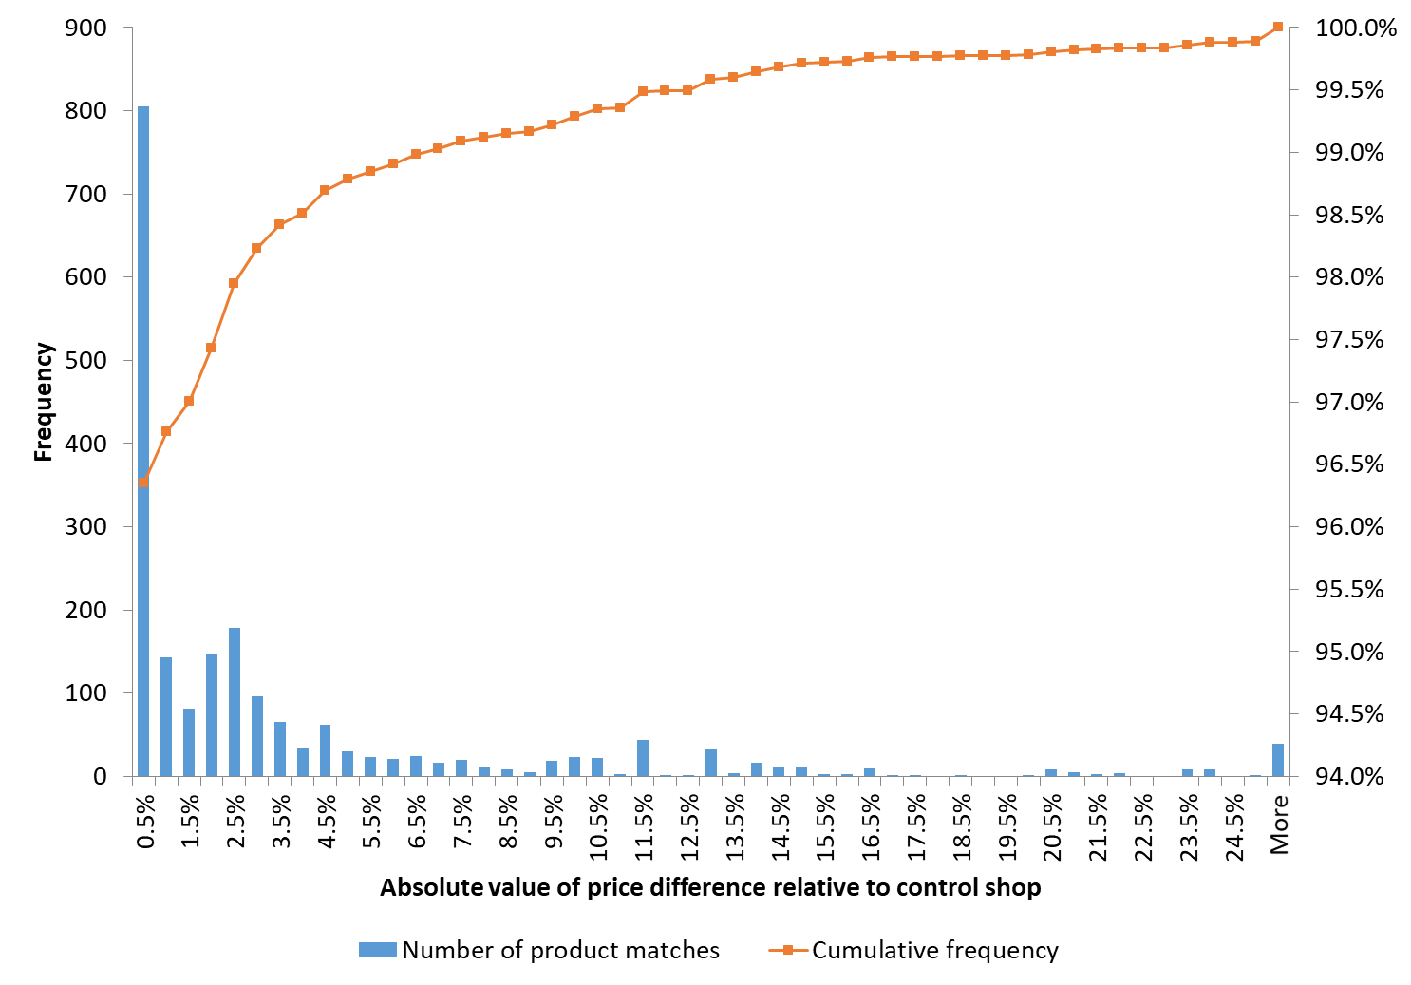
Distribution of products with non-zero price difference
In 94% of the 34,403 matched product pairs, there was no price difference at all
Among the remaining 6% product pairs, the median difference is < 1.6%
Notes:
The histogram shows the frequency distribution of products with non-zero price differences relative to the control shop.

Slide 14
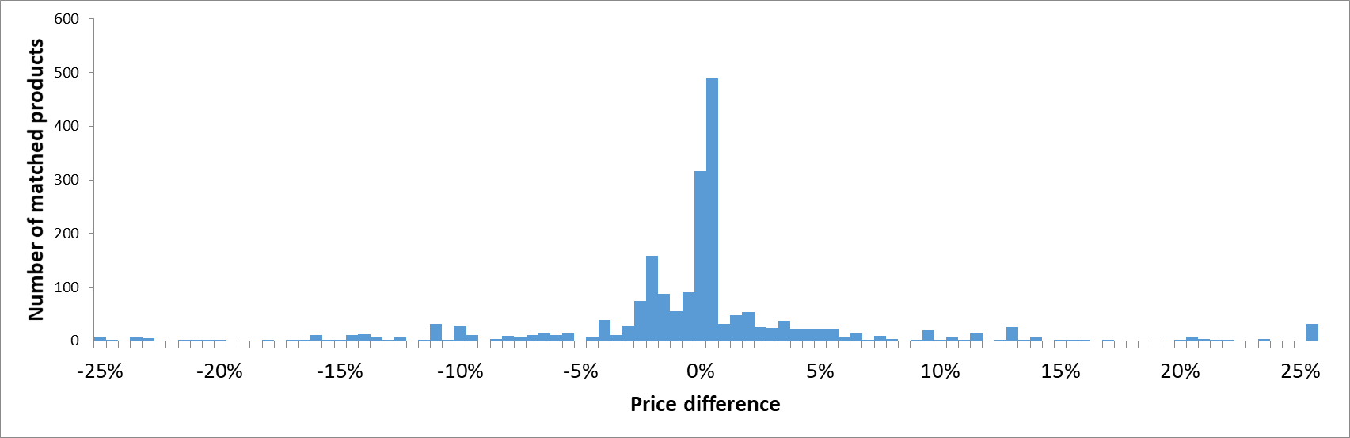
Relative frequency of % price differences between matched products
Price differences symmetric around the value of 0, i.e. small differences
in both positive and negative directions
Sample size: 2061 product matches with non-zero price difference

Slide 15
Evidence of online targeted advertising
Different types of online targeted advertising based on collected info of shoppers’ online behaviour:
- contextual - segmented - behavioural
EUROSTAT 2016: 25% of all enterprises (>10 ppl) use internet advertising. Of these:
- 78% have adopted contextual advertising &
- 27% behavioural advertising (much higher for large companies)
The study’s findings suggest that online targeted advertising is the most widespread online personalisation practice

Slide 16
Consumer awareness of personalised practices
Self-reported awareness (EU survey): - online targeted ads (67%) - personalised ranking of offers (62%) - personalised pricing (44%)
Perceived incidence (EU survey): - online targeted ads (70%) - personalised ranking of offers (53%) - personalised pricing (28%)
Self-reported awareness does not necessarily translate in ability to correctly identify online personalisation (behav. experiment)
  ~40% for targeted advertising, 37% for ranked offers based on previous search history, 17% for price personalisation (lower prices)
Increased transparency in communication of personalisation led to increase in % of correct identification of personalised ranking of offers only:
  from ~29% in low transparency treatments to 40% in high transparency treatments

Slide 17
Consumers’ concerns on online personalised practices
Targeted adverts:
  personal data could be used for other purposes /shared with 3rd parties (49%);
  their online data being collected/ a profile being made (46%);
  cookies installed on their computer (27%)
Personalised ranking of offers:
  personal data could be used for other purposes/shared with 3rd parties (46%);
  their online data being collected/ a profile being made (42%);
  cookies being installed on their computer (25%)
Personalised pricing:
  personal data could be used for other purposes/shared with 3rd parties (36%);
  their online data being collected/ a profile being made (33%);
  ending up paying more (28%)

Slide 18
Consumers’ perceived benefits of online personalised practices
  Targeted adverts: allowing to see interesting products (42%); reducing number of irrelevant adverts (23%); and funding free content (20%)
  Personalised ranking of offers: allowing to see interesting products (34%); saving time when searching online (23%); and making it easy to choose products that suits consumers’ needs (23%)
  Personalised pricing: allowing e-commerce websites to offer reductions/promotions (22%); allowing to get the best available price for products (21%); and allowing to increase product choice (15%)
No benefits whatsoever: 24% for targeted adverts, 25% for personalised ranking of offers, 32% for personalised pricing

Slide 19
Experiences & conditions for improvement
Bad experience(s) with personalised practices: 18% for online targeted adverts, 14% for personalised ranked offers, 12% for personalised pricing
No.1 bad experience (50%): been offered a product not/no longer interested

Slide 20
Influence of personalisation on consumer decisions
Personalisation practices & transparency in communication: No statistically significant impact on purchasing (72% chose to purchase a product)
The type of personalised practice had an impact on the probability that a personalised product was selected:
  targeted advertising with ranked offers: 62% of participants chose to purchase a personalised product (vs 50% in the baseline scenario)
  price discrimination scenario with lower prices: 66%
Higher transparency + easier to clear cookies: less people chose to switch to another platform (26% vs 34% in low transparency treatment)
Overall, 2.7% chose to clear cookies & search again. But 7.2% in the high transparency treatment where clearing cookies was easy in a 1-way step

Slide 21
Economic effects of online personalisation
Existing literature:
- behaviourally targeted advertising: fivefold increase in % of website visitors who complete a transaction
- online personalisation: benefits consumers if it shows products that best suit their needs, lowers prices or reduces search costs. Can benefit tech- savvy consumers
- negative effect for consumers if steered towards the most expensive products. May harm those not able/willing to search or with high willingness-to-pay
Market competitiveness:
intense competition → personalisation can benefit consumers - sellers can compete with each other to adapt prices
weak competition → personalisation helps sellers to extract more surplus
Wider long-term impacts: personalisation can limit range of products available to consumers - barriers to competition / innovation

Slide 22
Study published 17 July 2018 https://ec.europa.eu/info/publications/consumer-market-study-online-market-segmentation-through-personalised-pricing-offers-european-union_en
Konstantinos.Zisis@ec.europa.eu
Thanks for attending !

